Slide 1
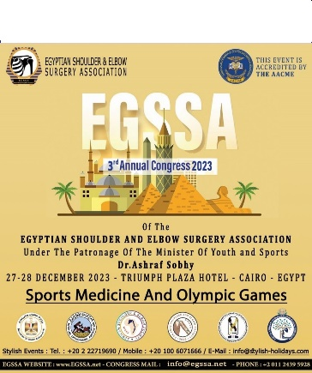
Reverse total shoulder arthroplasty in comminuted fractures of the upper extremity of the Humerus
Dr. KAMOUN HAITHEM
ORTHOPEDIC SURGERY DEPARTEMENT
SECURITY FORCES HOSPITAL - TUNISIA

Slide 2
INTRODUCTION
4 to 5% of all adult fractures
Osteoporotic patients +++
women +++ // Low-energy trauma

Slide 3
complex fractures = Big challenge in trauma surgery: no consensus on a treatment algorithm.
RTSA has been finding its place in the elderly

Slide 4
PURPOSE
RTSA IN UPHF : FUNCTIONNAL OUTCOME ?
RADIOLOGICAL OUTCOME ?
COMPARE RESULTS TO LITERATURE.

Slide 5
METHODS
Descriptive FROM 2016 TO 2019.
retrospective TOTAL : 30 PATIENTS
RTSA IN UPHF
Inclusion | Exclusion
Displaced 3- and 4-part fractures. Treated by RTSA within <3 weeks of the date of trauma. A minimum of 12 months after the date of surgery. | RSA operated patients with degenerative pathologies, trauma sequelae and inveterate dislocations. Revision prostheses. Patients lost to follow-up.

Slide 6
WE STARTED BY ANATOMICAL DATA COLLECTION :
AGE
GENDER
DOMINANT SIDE
OCCUPATION
AFFECTED SIDE
MEDICAL BACKGROUND
CIRCUMSTANCE OF OCCURANCE

Slide 7
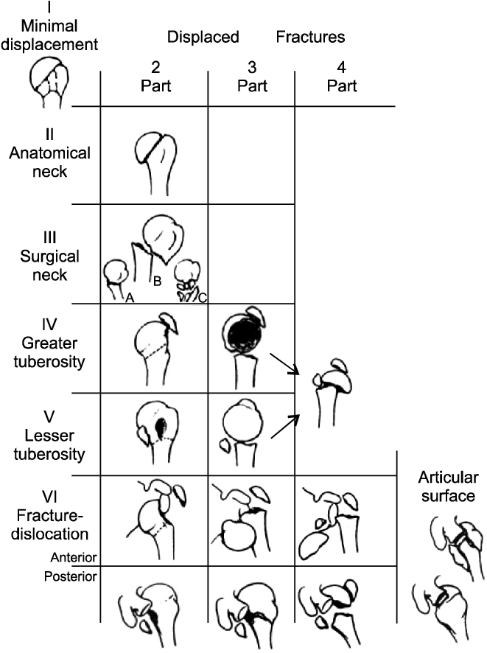
RADIOLOGY PRE OP DATA COLLECTION
X RAY FRONT / SIDE
CT SCAN +++
NEER CLASSIFICATION

Slide 8
THERAPEUTIC DATA :
OPERATING TIME
INSTALLATION TYPE
TYPE OF ANESTHESIA

Slide 9
FUNCTIONNAL OUTCOME
OBJECTIVE CONSTANT SCORE
SUBJECTIVE SHOULDER VALUE %

Slide 10
RADIOLOGICAL OUTCOME
TUBERTOSITY STATUS
SCPAULAR NOTCH : SIRVEAUX CLASSIFICATION

Slide 11
RESULTS
AVERAGE : 68
> 70 ANS : > 50%

Slide 13
Pathological history | Number | Percentage
None | 5 | 17%
arterial hypertension | 20 | 66%
Diabetes | 11 | 36%
Dyslipidemia | 6 | 20%
Gout | 2 | 6%
Osteoporosis | 2 | 6%
Anemia | 2 | 6%
Epilepsy | 1 | 3%
Asthma | 1 | 3%
Osteoarticular tuberculosis | 1 | 3%
persistent atrial fibrillation | 1 | 3%
Hypothyroidism | 1 | 3%
Hepatitis B | 1 | 3%
ESSENTIALLY HYERTENSION AND
DIABETES

Slide 14
LATERATLITY AND PROTHESIS SIDE
RIGHT HANDED : 80 %
RSA IN DOMINANT SIDE : 56 %

Slide 15
Distribution of patients by circumstances of trauma
DOMESTIC ACCIDENT > 80%

Slide 16
Distribution of fractures according to Neer's classification
CT scans were performed in all our patients:
- NEER 3 fracture in 6 cases and NEER 4 fracture in 24 cases.
- Pathological rotator cuff in 100% of cases.

Slide 17
Between the date of the trauma and the intervention, the average delay was 7 days (Minimum:1 day and Maximum:16 days).
Beach chair position, was used in 100% of cases.
100 % general anesthesia, which was combined in 73% of cases with a locoregional block to obtain postoperative analgesia.

Slide 18
Approach
The mean follow-up was 18 months, with extremes ranging from 12 to 36 months.
REHABILITATION : STARTED FROM DAY 15 // WELL-FOLLOWED : 86 %

Slide 19
POST OP RESULTS
Post-operative amplitudes
Active range of motion | Overall average (Min-Max)
Antepulsion | 98° (70°-120°)
Abduction | 97° (70°-120°)
RE1 | 18° (10°-25°)

Slide 20
SUBJECT SHOULDER VALUE

Slide 21
CONSTANT SCORE
values Items | Average | (Min – Max)
Pain ( /15) | 13 | 12 - 14
Activity ( /20) | 15 | 13 - 18
Mobility ( /40) | 23 | 20 - 25
Strength ( /25) | 5 | 4 - 7
Distribution of patients by Constant absolut score
Absolute Constant score by reading items separately

Slide 22
RADIOLOGICAL OUTCOMES
scapular notch | 3 patients : Grade 1 | 10 %
Peri prosthetic calcification | 4 patients | 13 %
Distribution of patients by tuberosity status

Slide 23
Mobilité | fracture Type | Average (Min-Max) | P
Abduction | Neer 3 | 101° (90-120) | 0,31
 | Neer 4 | 96° (70-110)
Antepulsion | Neer 3 | 100° (90-110) | 0,6 5
 | Neer 4 | 98° (70-120)
External Rotation | Neer 3 | 17° (10-20) | 0,84
 | Neer 4 | 18° (10-25)
Assessment of average mobility according to fracture type
 | Fracture type | Average | Min | Max | P
Constant Score | Neer 3 | 57 | 49 | 67 | 0,63
 | Neer 4 | 59 | 34 | 85
Absolute Constant score by fracture type

Slide 24
 | Fracture type | Median | Min | Max | P
SSV | Neer 3 | 79 | 70 | 90 | 0,26
 | Neer 4 | 74 | 30 | 90
SSV distribution by fracture type
 | Tuberosity status | Average | Min | Max | P
Antépulsion | Consolidated | 103° | 90° | 120° | 0,01
 | Non Consolidated | 91° | 70° | 100°
External rotation | Consolidated | 20° | 15° | 25° | 0,001
 | Non Consolidated | 14° | 10° | 20°
Abduction | Consolidated | 102° | 80° | 120° | 0.03
 | Non Consolidated | 91° | 70° | 100°
Assessment of joint amplitudes according to tuberosity status

Slide 25
 | tuberosity status | Median | M Min | Max | P
SSV | Consolidated | 84 | 74 | 90 | 0,001
 | Non Consolidated | 70 | 30 | 80
SSV distribution by tuberosity status
 | tuberosity status | Median | M Min | Max | P
Constant Score | Consolidated | 64 | 49 | 85 | 0,01
 | Non Consolidated | 50 | 34 | 62
Distribution of absolute constant score according to tuberosity status

Slide 26
RELATION WITH | SSV | CSA | ROM
FRACTURE TYPE | NO | NO | NO
TUBEROSITY STATUS | YES | YES | YES

Slide 27
COMPLICATIONS
COMPLICATIONNUM | NUMBER OF CASES
AXILLAR NERVE PARALYSIS | 1
INFECTION | 1
PERIPROSTHETIC FRACTURE | 1
INSTABILITY | NO

Slide 28
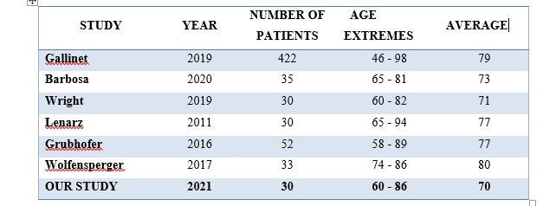
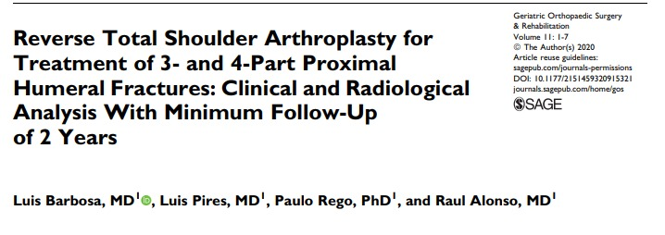
DISCUSSION
The average age of patients in most series is over 70.

Slide 29
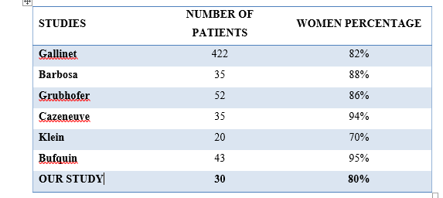
Most of the studies, including our own, are predominantly female, with women accounting for 80%.

Slide 30
FALLING MECHANISM

Slide 31
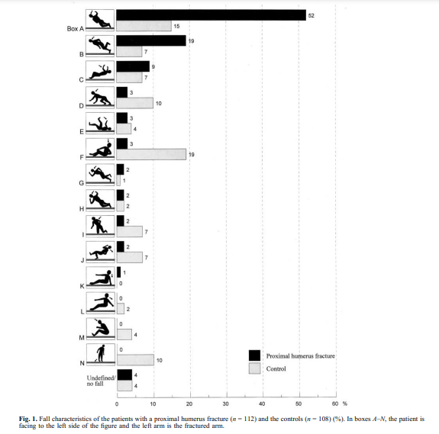

Slide 32
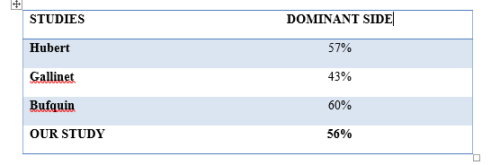
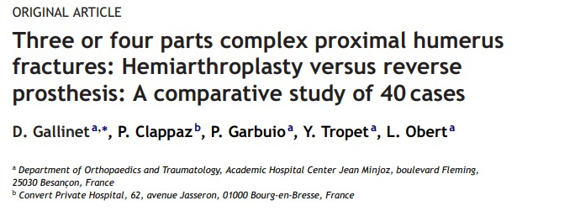
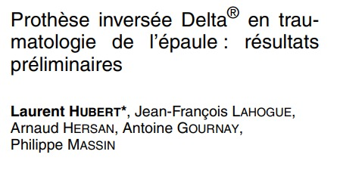
DOMINANT SIDE
Percentage of dominant side in the literature

Slide 33
WHAT ABOUT CLASSIFICATIONS ?

Slide 34
CLASSIFICATIONS
DUPARC
AO
HERTEL
NEER

Slide 35
WHY NEER CLASSIFICATION ??

Slide 36
THE IMPORTANCE OF ANTEROLATERAL ASCENDING BRANCH +++
1 : branche antérolatérale ascendante
2 : artère circonflexe postérieure
3 : artère circonflexe antérieure
NEER CLASSIFICATION ALLOWS TO ESTIMATE THE RISK OF HUMERAL HEAD NECROSIS ESPECIALLY FOR NEER 3 AND 4 FRACTURES.

Slide 37
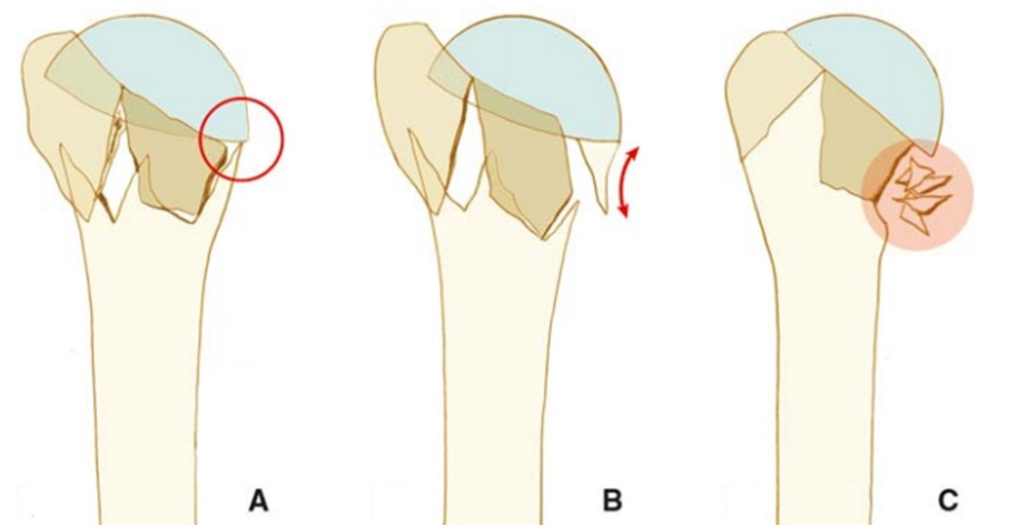
THE IMPORTANCE OF MEDIAL METAPHYSEAL HINGE

Slide 38
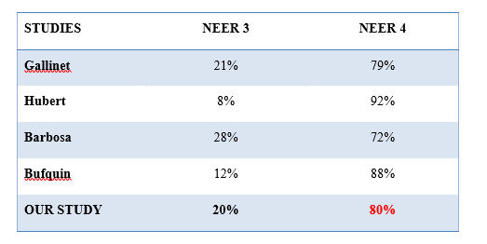
TYPE OF FRACTURE

Slide 39
HOW TO MANAGE UPPER HUMERUS FRACTURES ?

Slide 40
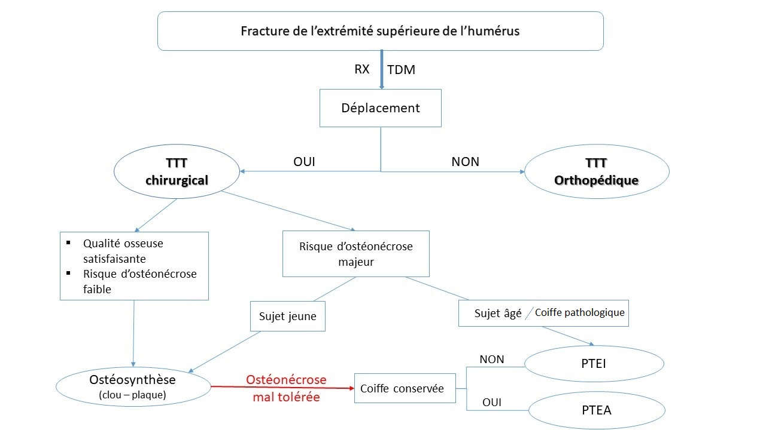

Slide 41
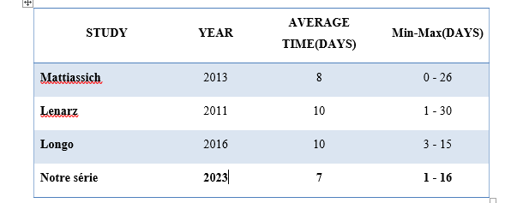
TIME TO OPERATION

Slide 42
WHICH APPROACH??

Slide 43
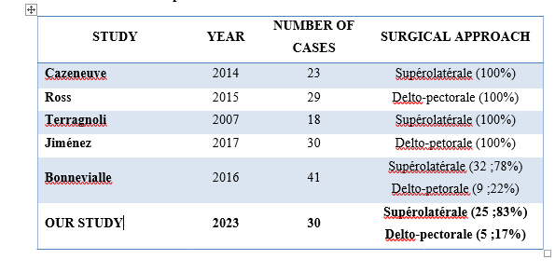
Distribution of approaches in literature series

Slide 44
 | DELTO PECTORAL | SUPERO LATERALAL
DELTOIDE DAMAGE | NO | YES
GLENOID VIEW | + | -
GREATER TUBEROSITY REINSERTION | - | +
AXILLARY NERVE LESION | NO | YES
GLENOID NOTCH | NO | POSSIBLE
SUBSCAPULARIS // ANTERIOR GLENO HUMERAL LIGAMENTS DAMAGE | YES | NO
POSSIBILTY OF DIAPHYSEAL EXTENSION | YES | -

Slide 45
REHABILITATION
AIM : FUNCTIONNAL PAIN FREE SHOULDER
PHYSIOTHERAPIST ASSISTANCE WITH SIMPLE MOVEMENTS
RECOMMENDED NEUTRAL ROTATION IMMOBILIZATION ( GREATER TUBEROSITY MIGRATION !!!) FOR 4 WEEKS
EARLY PASSIVE REHABILITATION +++

Slide 46
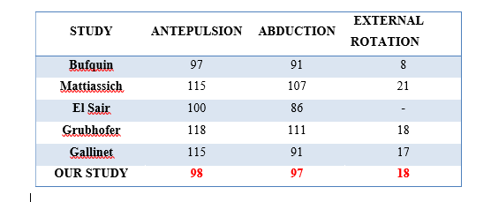
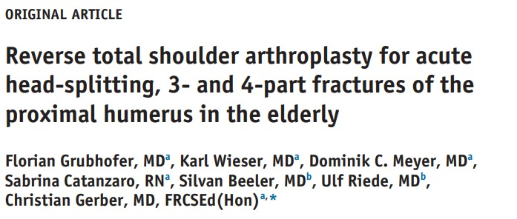
LAST FOLLOW UP ACTIVE ROM
SATISFACTORY RESULTS !

Slide 47
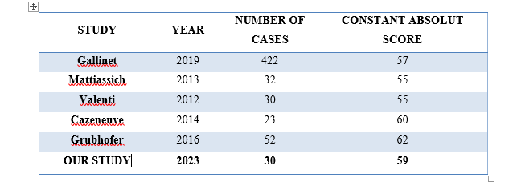
ABSOLUT CONSTANT SCORE
SATISFACTORY RESULTS !

Slide 48
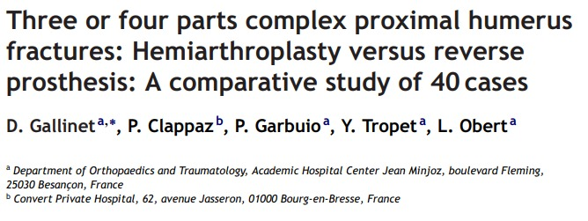
LAST FOLLOW UP RSA INFLUENCE ON PAIN MOBILITY ACTIVITY AND MUSCLE STRENGTH
STRENGTH
MOBILITY
PAIN
ACTIVITY
NO RSA FOR YOUNG PATIENTS

Slide 49
LAST FOLLOW UP SSV
SATISFACTORY RESULTS !

Slide 50
LAST FOLLOW UP TUBEROSITY STATUS
ANATOMIC GT REINSERETION GIVES BETTER EXTERNAL ROTATION AND FUNCTIONNAL OUTCOME.

Slide 51
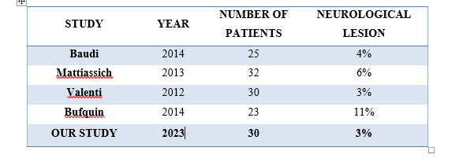
NEUROLOGICAL COMPLICATIONS
SAME RESULTS IN LITERATURE

Slide 52
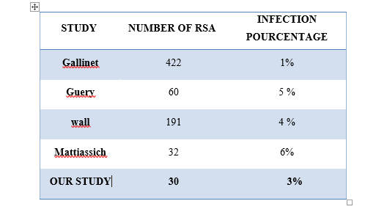
INFECTION
RISK FACTORS :
DIABETES
IMMUNODEPRESSION
POST OP HEMATOMA

Slide 53
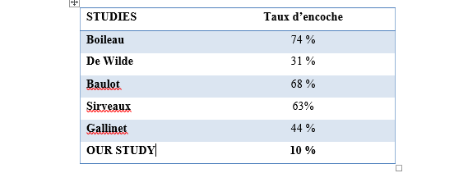
SCAPULAR PILLAR NOTCH
LESS THAN STAGE 3 HAS NO INFLUENCE IN FUNCTIONNAL OUTCOME

Slide 54
SCAPULAR PILLAR NOTCH
RISK IF :
HIGH POSITION OF GLENOSPHERE
SUPERIOR ORIENTATION OF GLENOSPHERE
HIGH ACTIVITY

Slide 55
HOW TO AVOID IT ?

Slide 56
BY :
OBERHANG OF GLENOSPHERE FROM LOWER EDGE OF GLENOID
DOWNWARD TILT OF GLENOID BASE
LATERALIZATION OF THE CENTER OF ROTATION
INCREASING THE SIZE OF GLENOSPHERE

Slide 57
CONCLUSION
In the past, RSA was the treatment of choice for eccentric omarthrosis,
with the functional outcome of a pain-free, mobile shoulder.
Today represents an interesting surgical alternative with satisfactory
and predictable outcomes for the management of complex fractures of
the proximal humerus, especially in the elderly.

