Slide 1
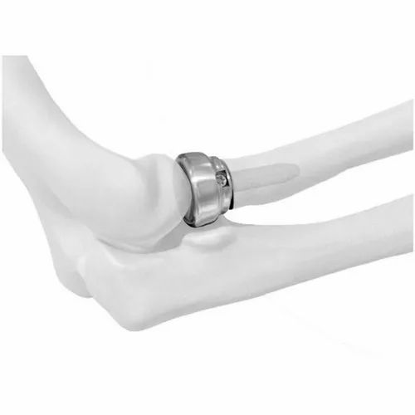
Eslam Shafik A. lecturer orthopaedic department Zagazig university
Elbow radial head prothetic replacement in management of radial head fractures

Slide 2
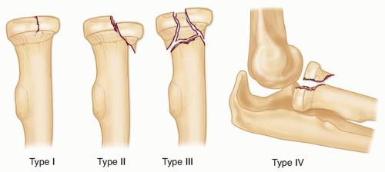
Classification of radial head fractures
Type I
Nondisplaced or minimally displaced (<2mm), no mechanical block to rotation
Type II
Displaced >2mm or angulated, possible mechanical block to forearm rotation
Type III
Comminuted and displaced, mechanical block to motion
Type IV
Radial head fracture with associated elbow dislocation

Slide 3
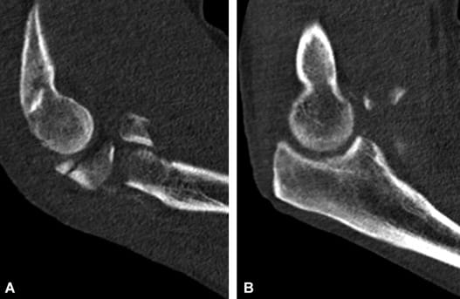
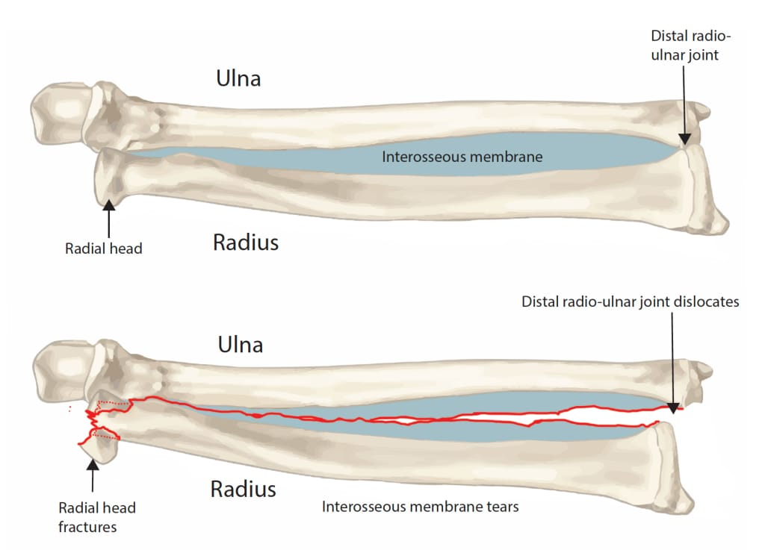
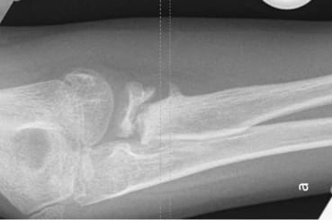
Indications OF radial head arthroplasty
comminuted fractures (Mason Type III) Esp with dislocation
nonunion/malunion
Essex-Lopresti lesions
radial head excision will exacerbate elbow/wrist instability and may result in proximal radial migration and ulnocarpal impingement

Slide 4
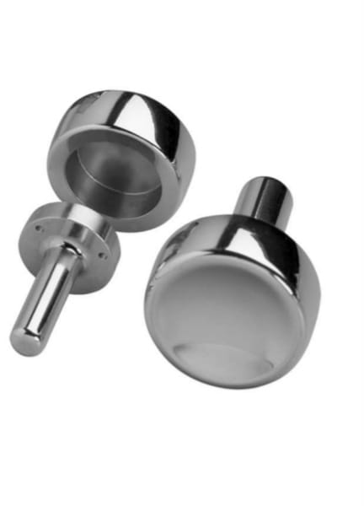
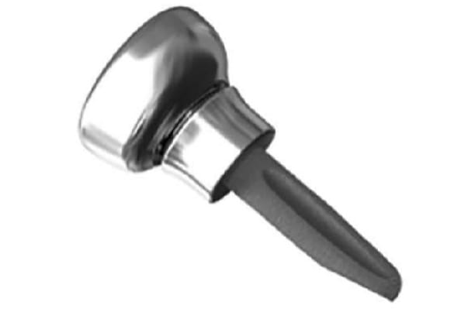
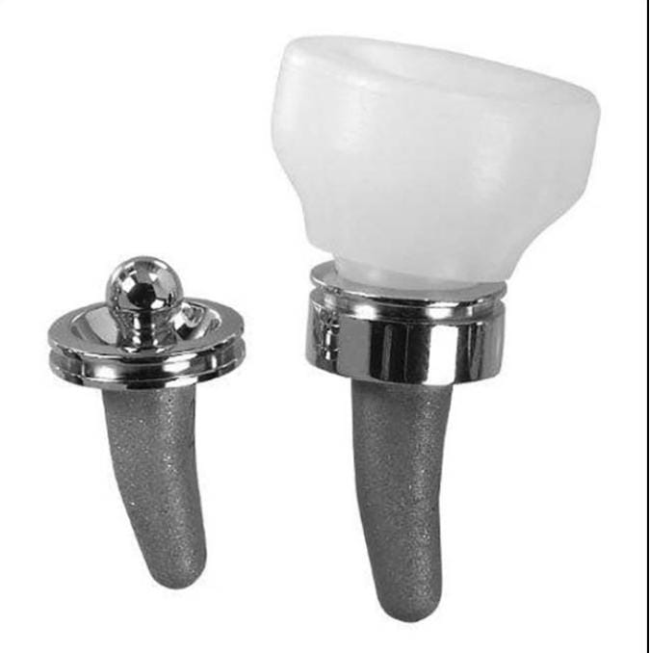
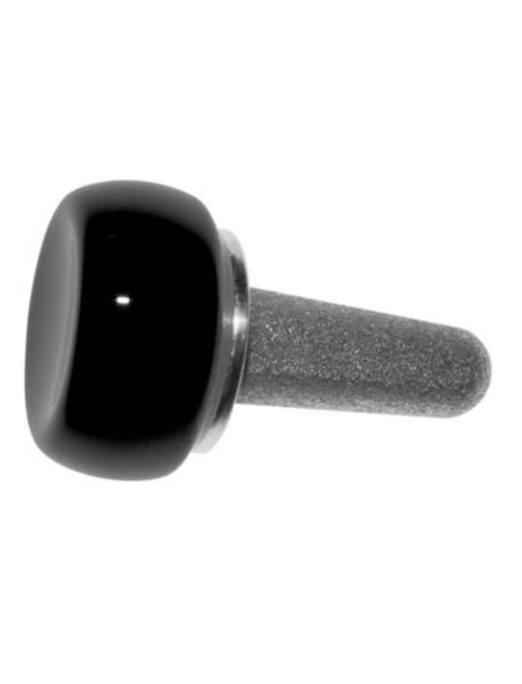
Types of prothesis
loose stemmed prosthesis
acts as a stiff spacer
thought to "settle in" to anatomic position throughout arc of motion
press-fit prosthesis
depend on osteointegration and tight canal fit
may be more prone to incorrect intramedullary positioning given tight fit
bipolar prosthesis
has an articulation in the head-neck junction
thought to allow better articulation of radial head to capitellum throughout arc of motion
may facilitate elbow instability when the radial head angles in reference to the radial stem
pyrocarbon prostheses
pyrocarbon implant thought to better approximate modulus of cartilage and decrease risk of capitellar wear from metallic radial head implant

Slide 5
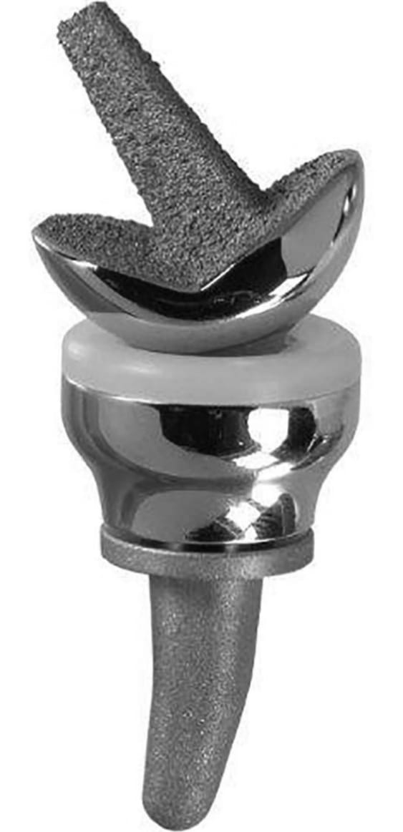
Radio capitular prothesis

Slide 6
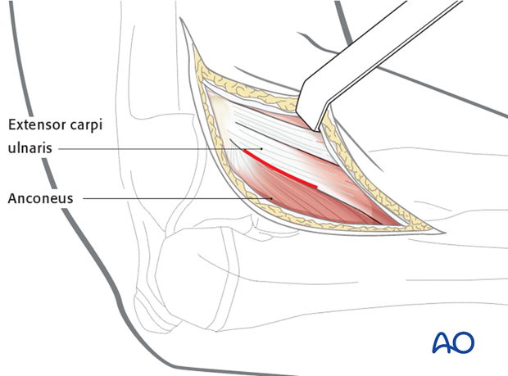
Technichal consederations
Kocher approach
interval
between ECU (PIN) and anconeus (radial n.)
key steps
incise posterior fibers of the supinator
incise capsule in mid-radiocapitellar plane
anterior to crista supinatoris to avoid damaging LUCL
the forearm should be pronated to protect PIN (pronation maintain the PIN posterior away from surgical field ) .

Slide 7
Technichal considerations
Exise the broken head radius fragments with preservation of the neck
Insert the trials with avoiding joint overstuffing
excessive length leads to abnormal loads with early progressive capitular erosions
Incorrect diameter radial head prosthesis has cam effect which produces abnormal loads through the lateral aspect of the trochlea and the lesser sigmoid notch

Slide 8
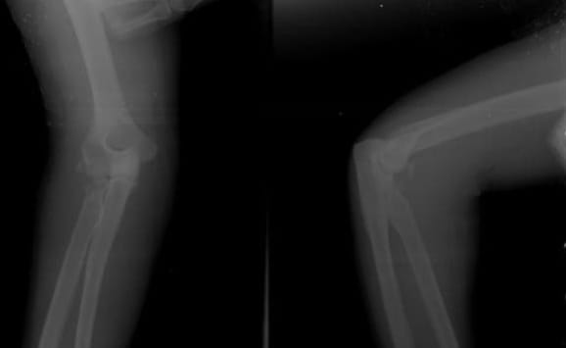
Case presentation No(1)
Male patient 35 years old RTA
Comminuted fracture head radius
X-Ray

Slide 9
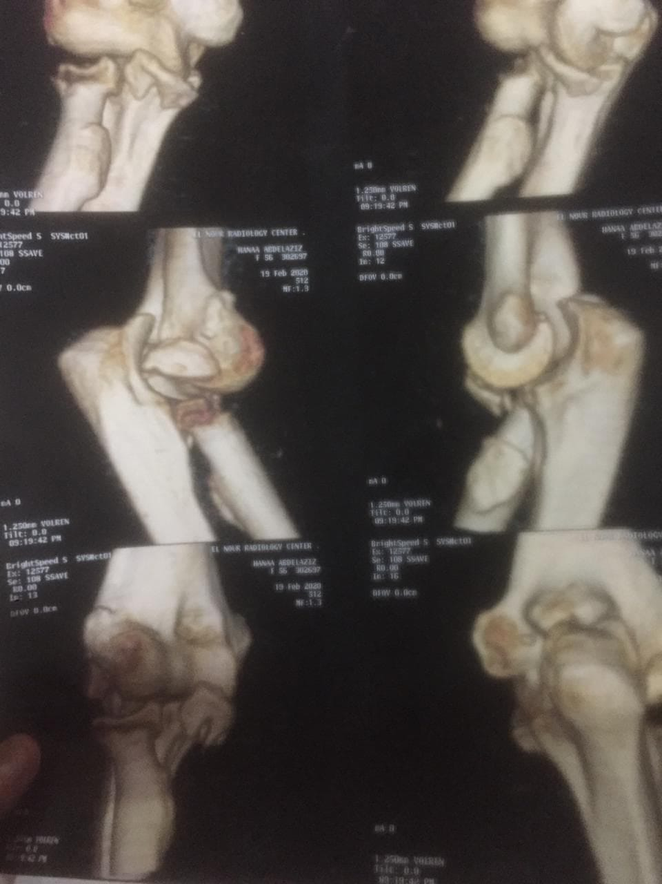
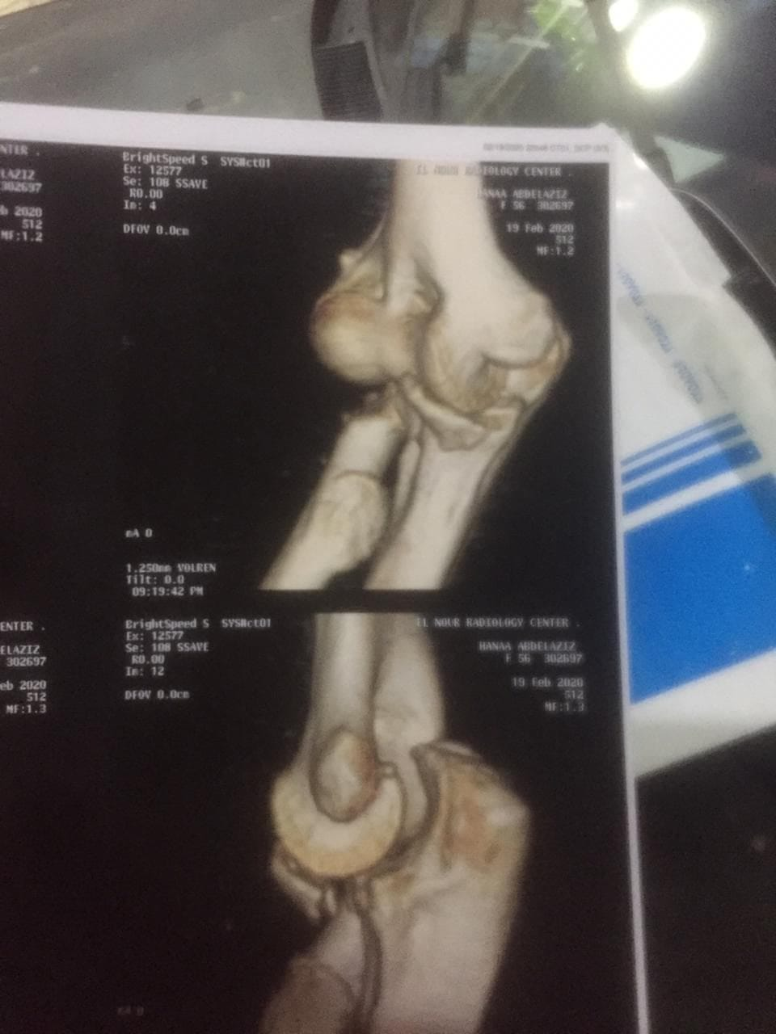
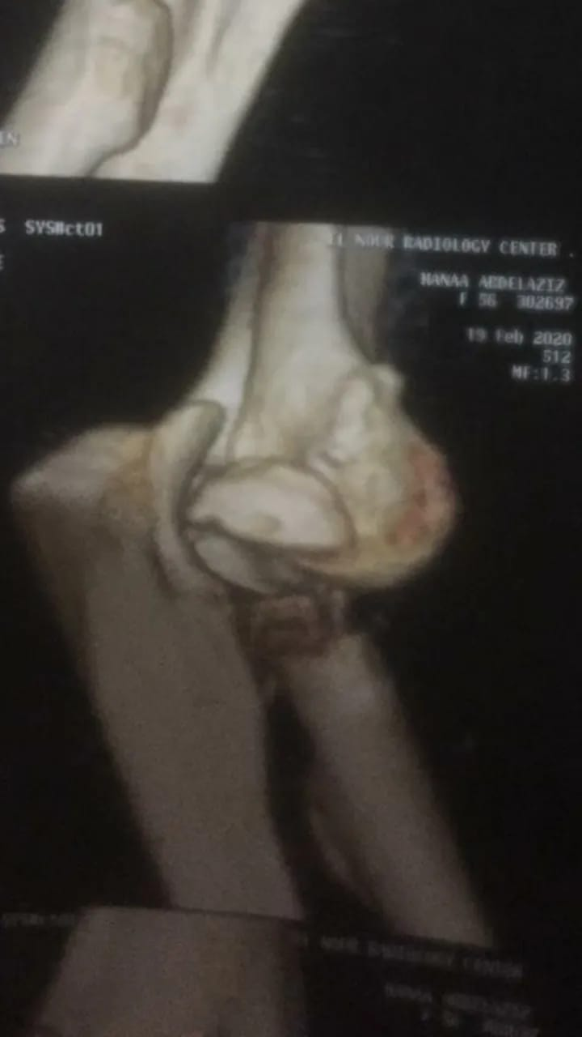
CT Scan

Slide 12
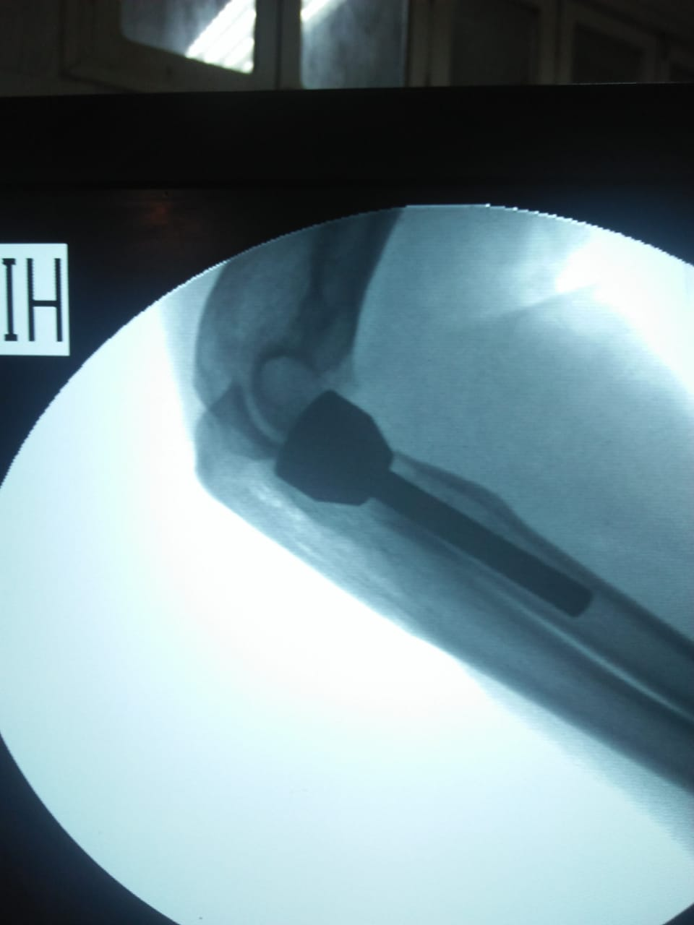
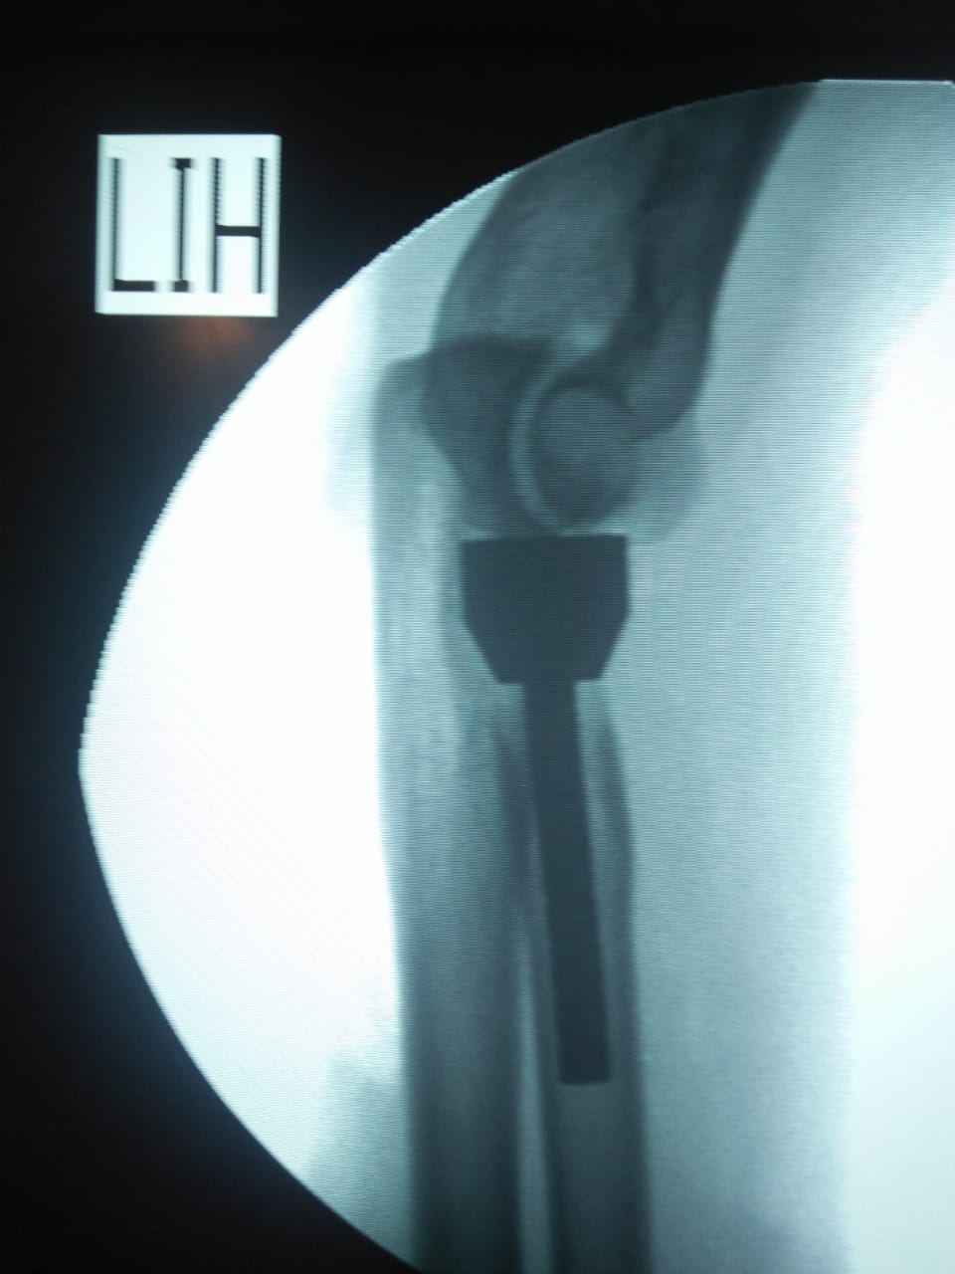
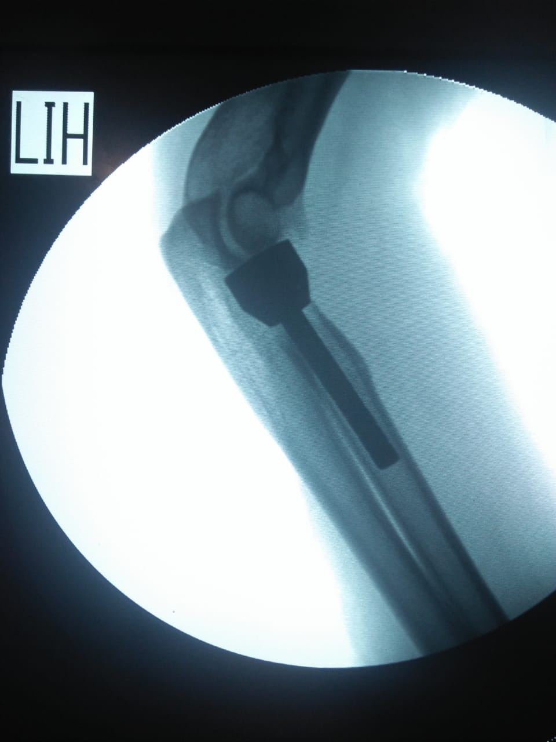
Post x-Ray

Slide 13
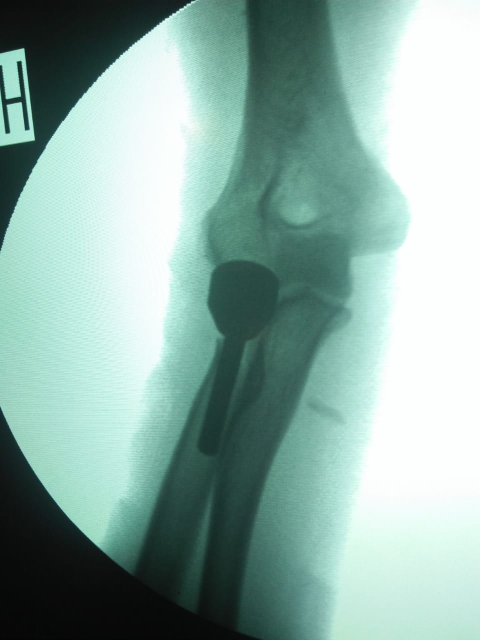
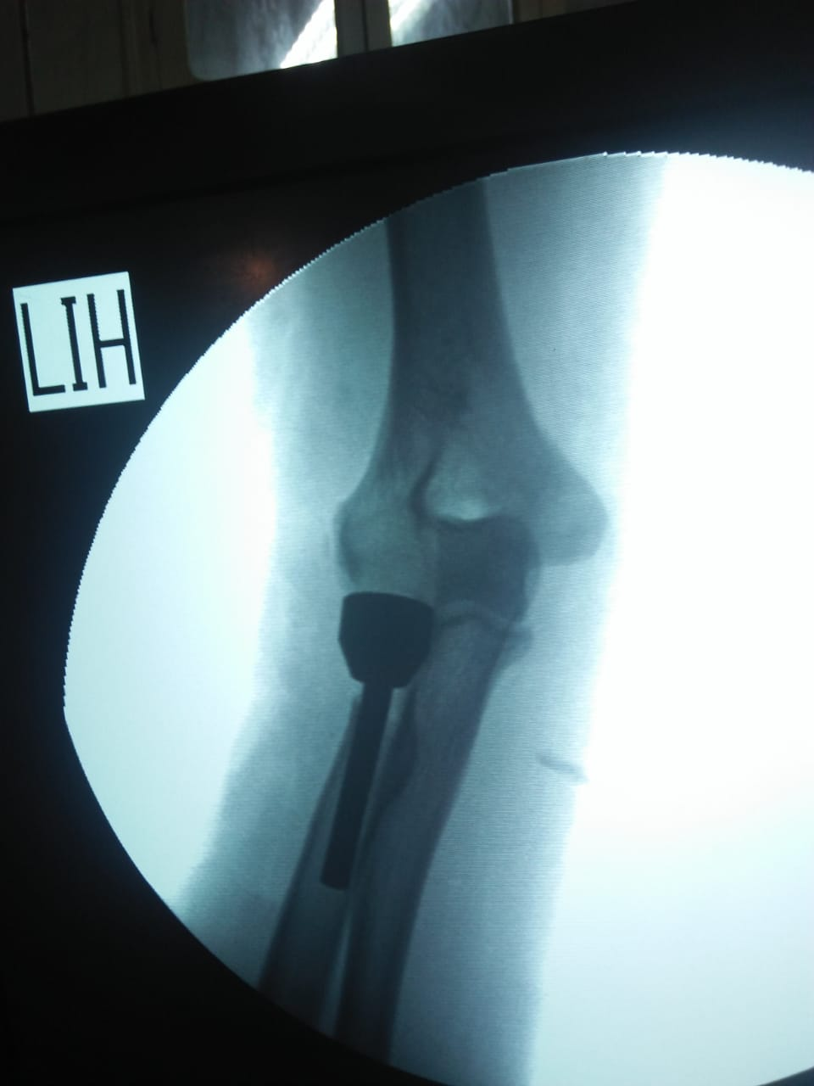
Post X-Ray

Slide 14
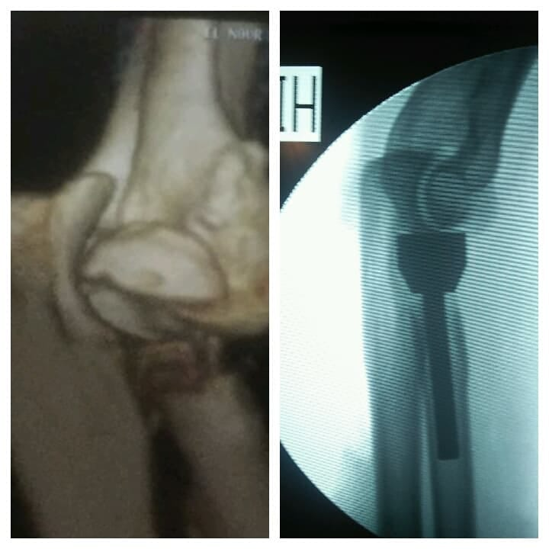
Pre & Post X-Ray

Slide 16
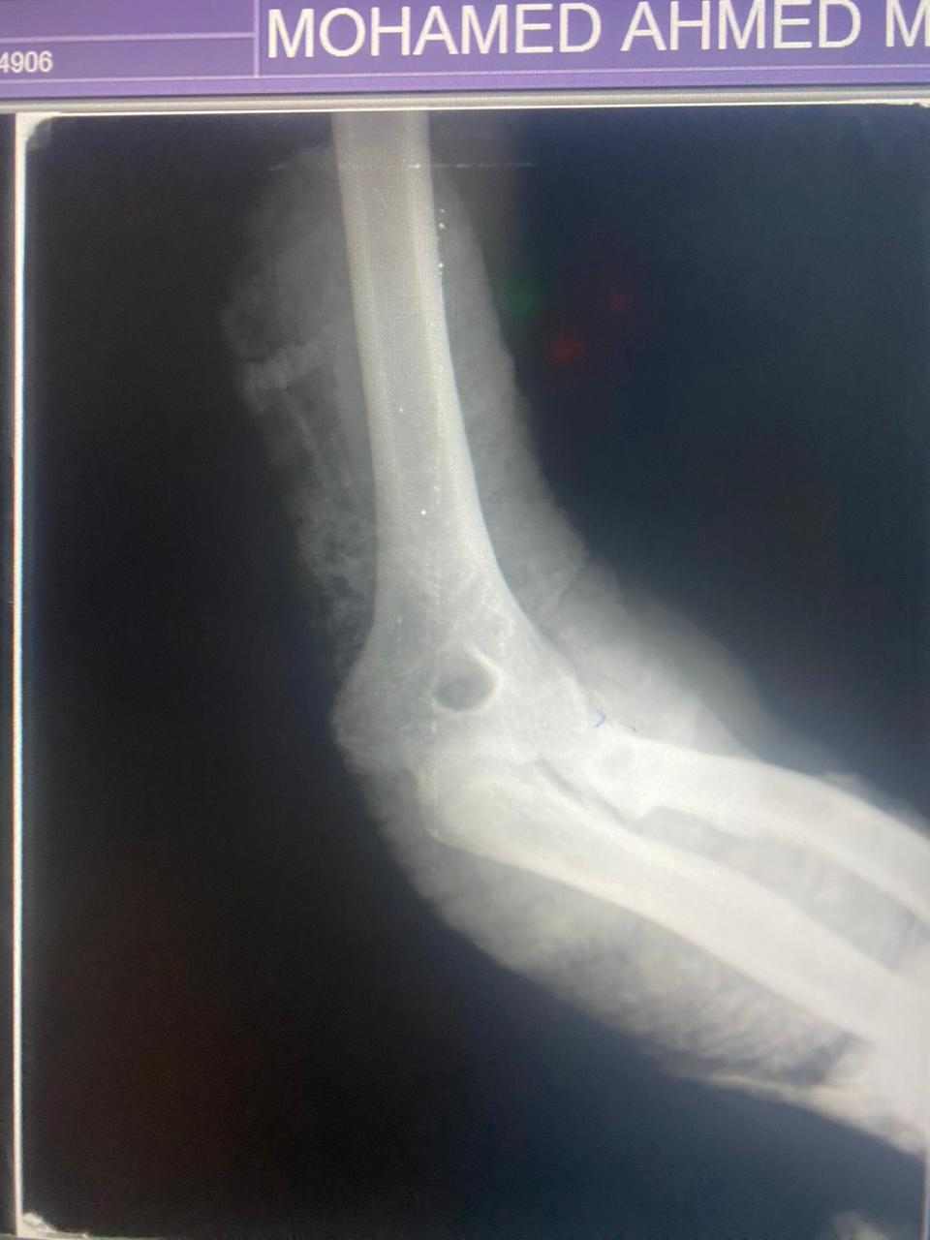
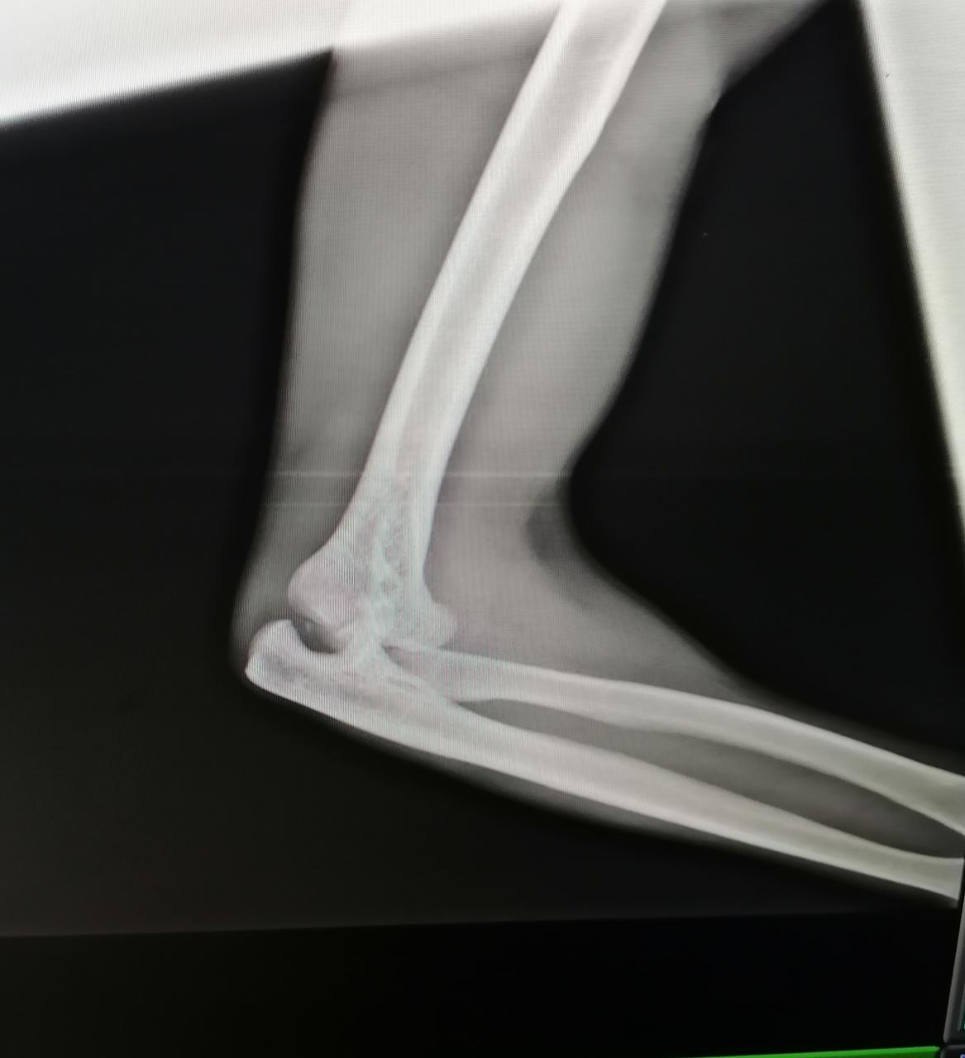
Case presentation no (2)
Male patient 47 years old RTA
Comminuted fracture head radius
X-Ray

Slide 17
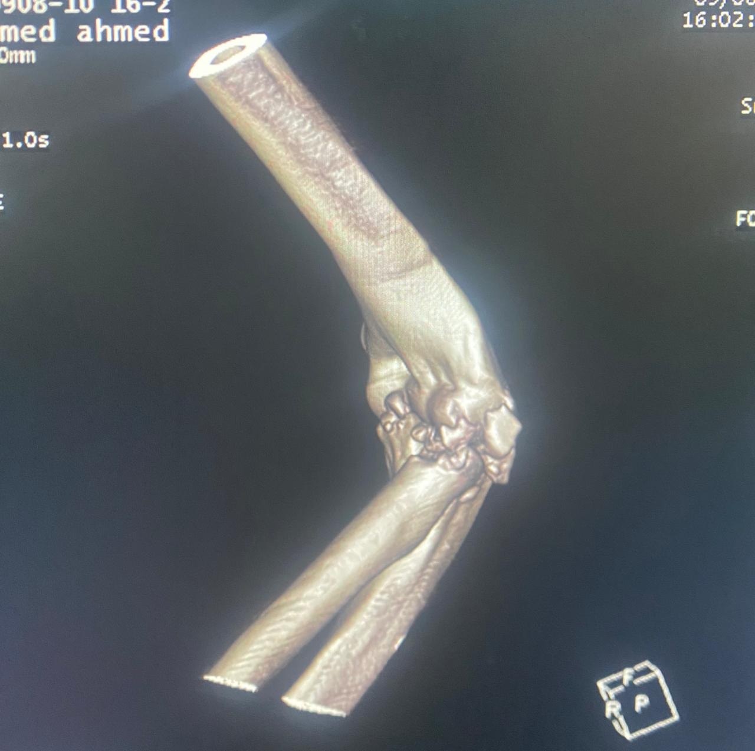
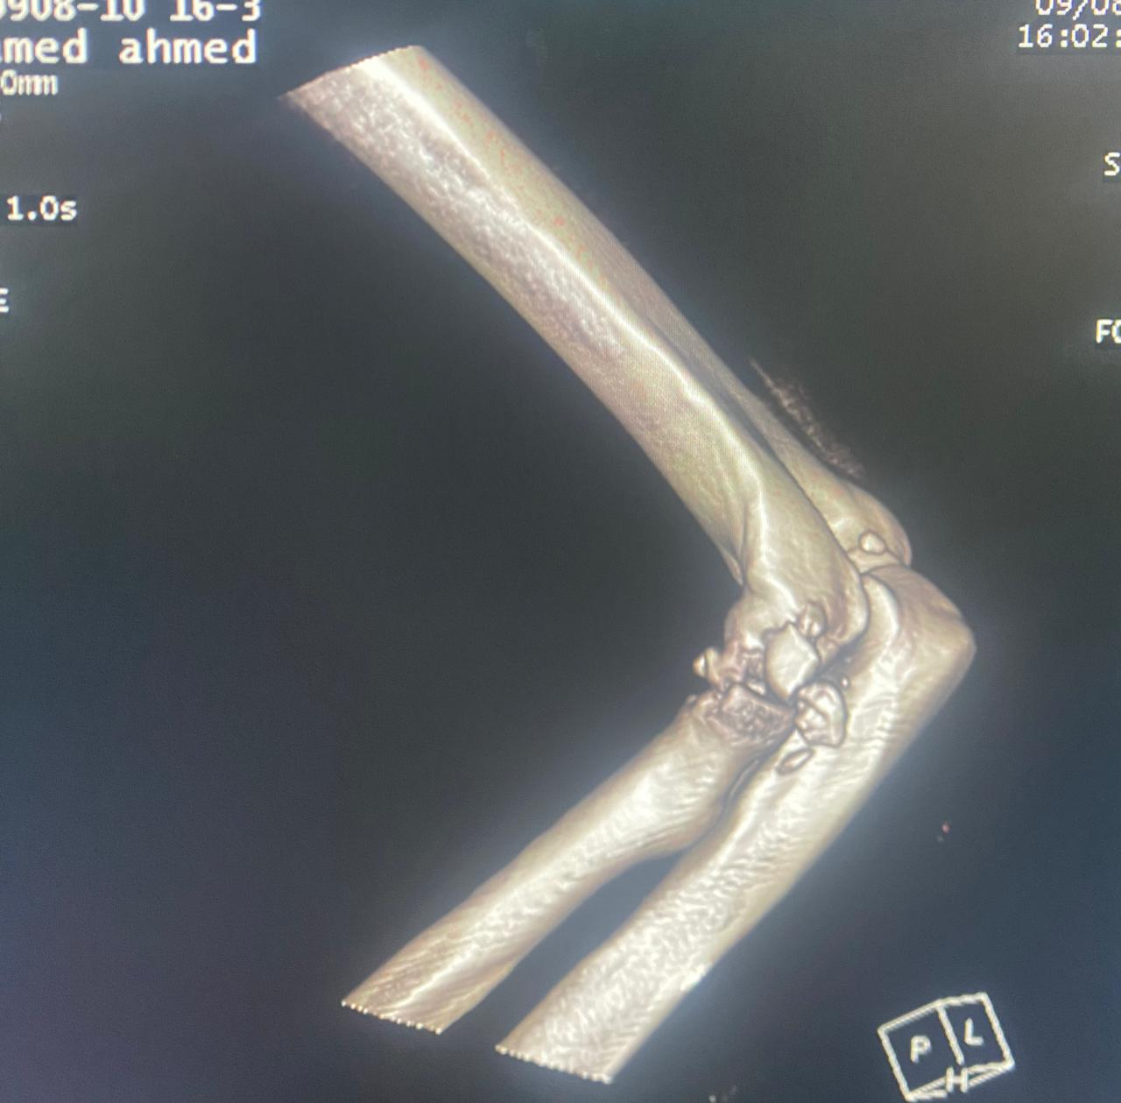
CT-Scan

Slide 18
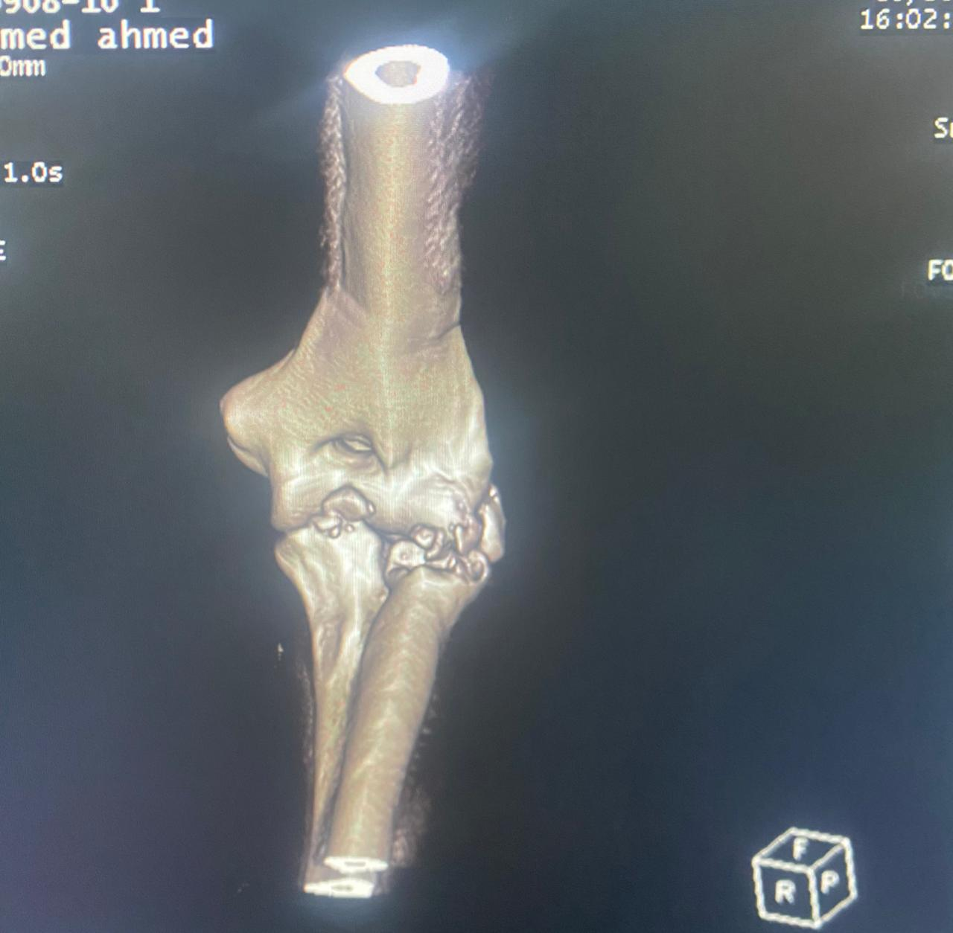
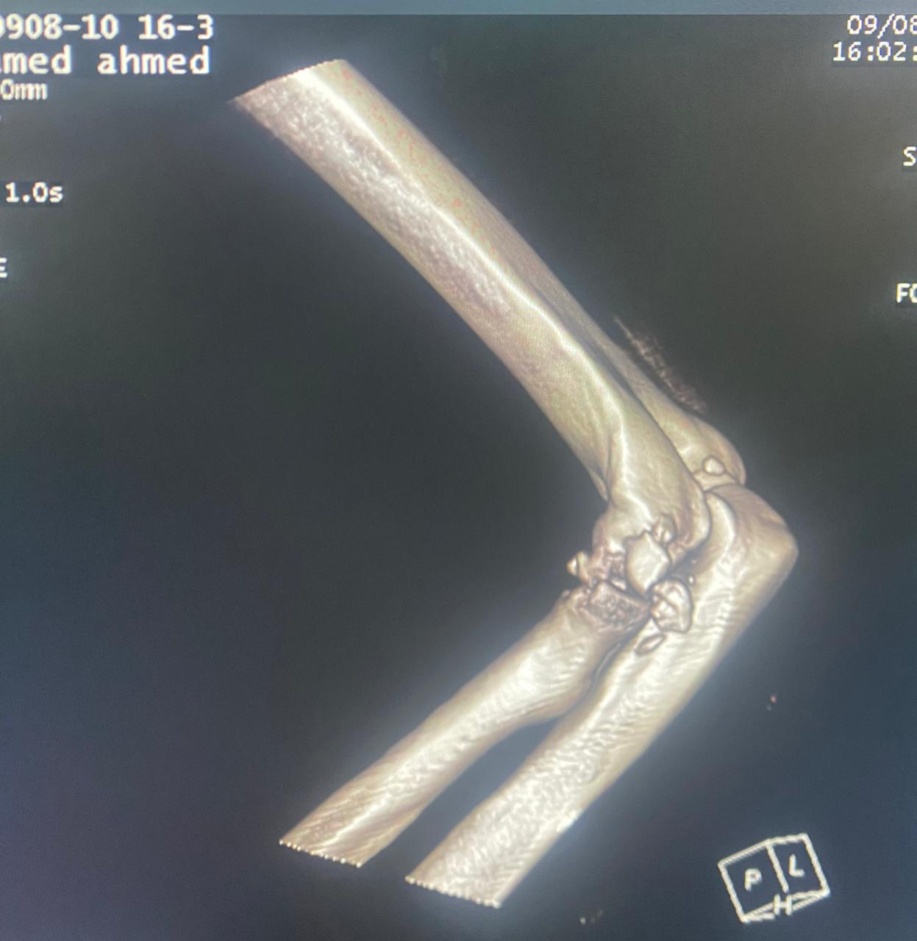
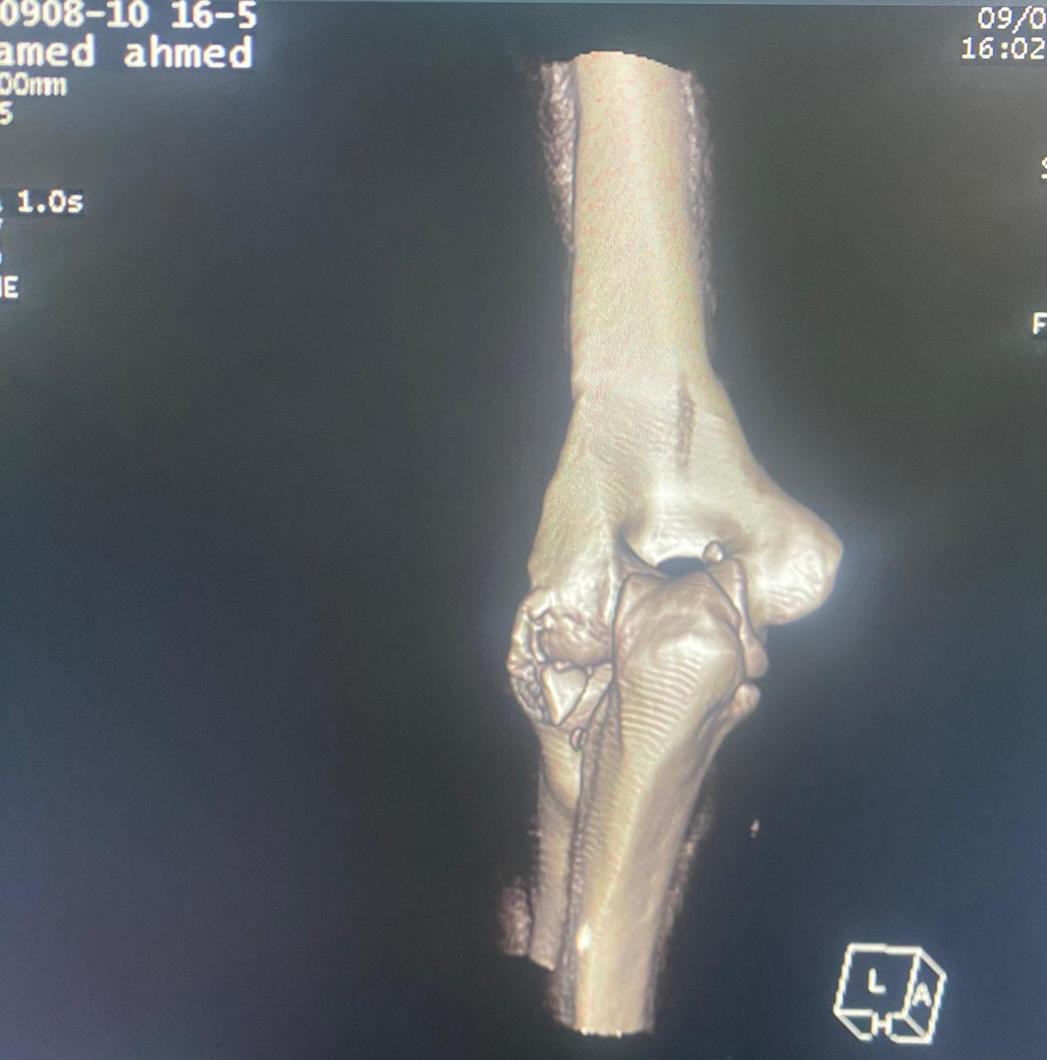

Slide 19
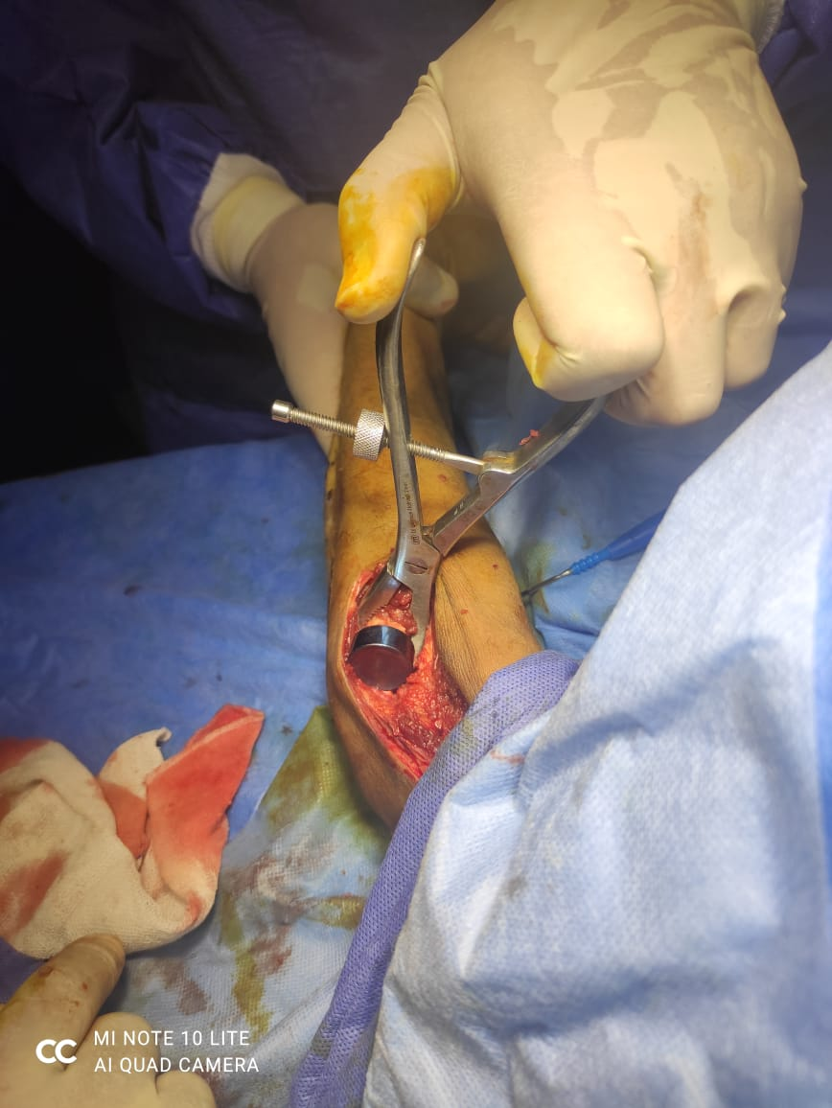
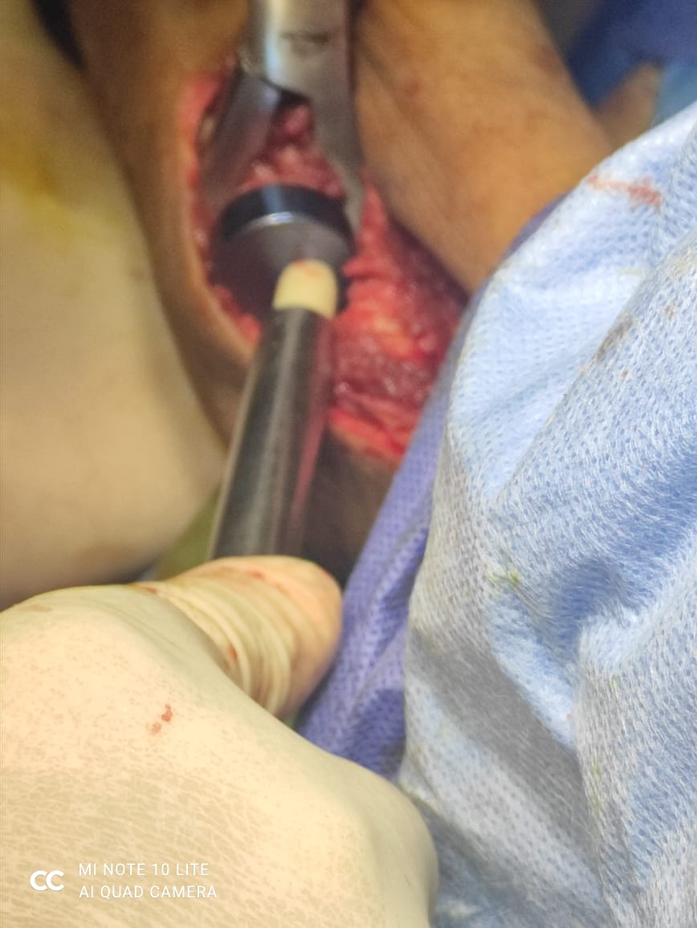
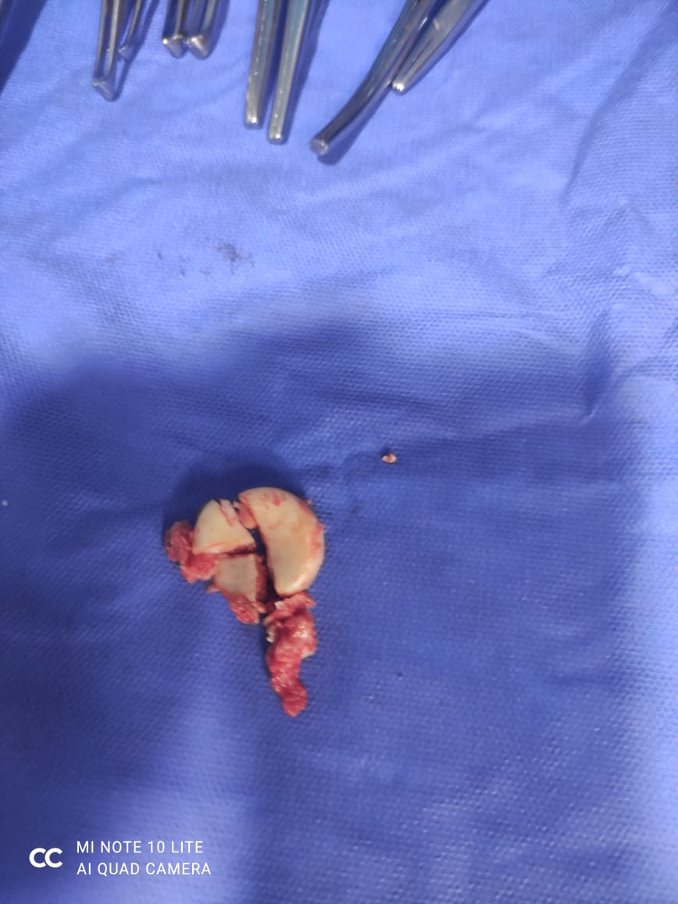
During Operation

Slide 20
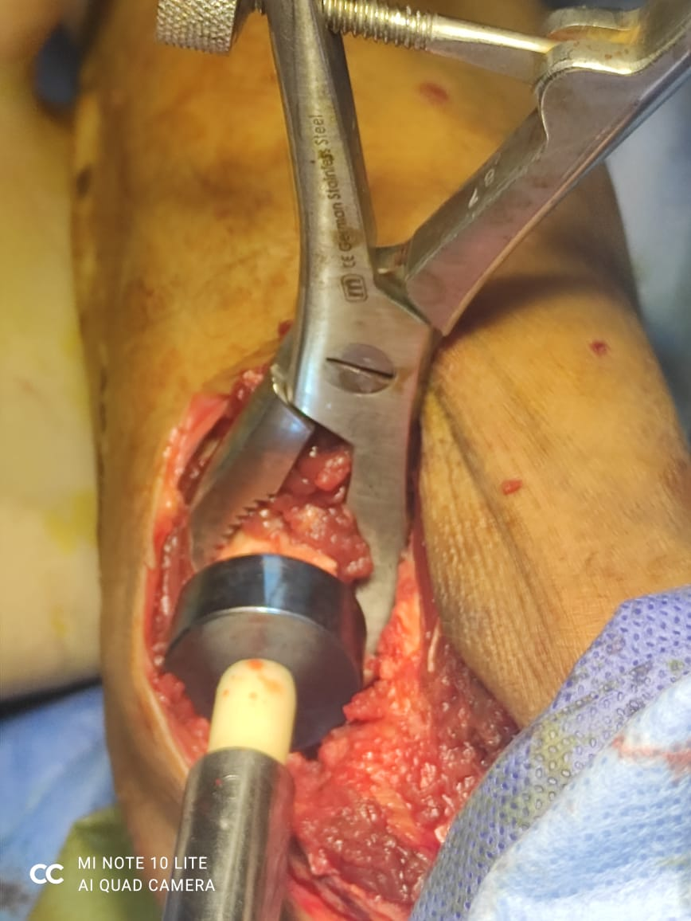
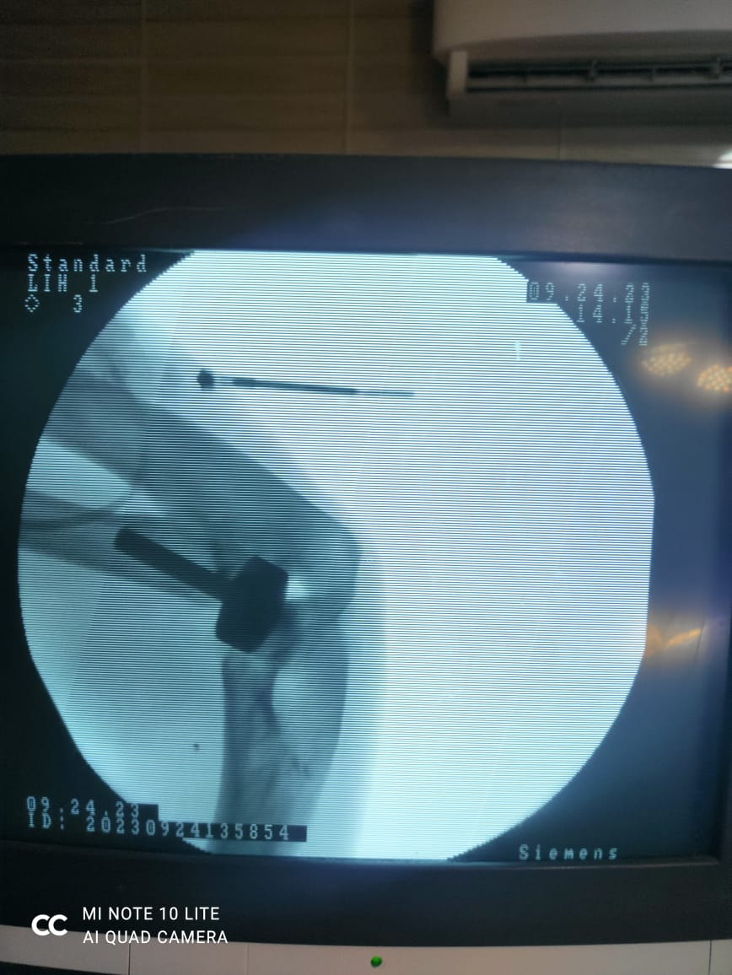

Slide 21
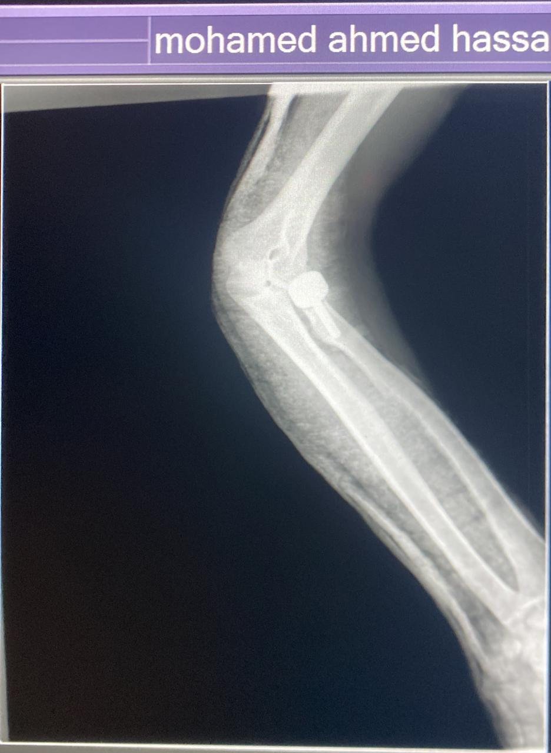
Post X-Ray

Slide 23
Thank you

