Slide 1
The Athlete’s Shoulder
Bashir A. Zikria, MD. MSc
Chief of Surgery Aspetar Sports Medicine Hospital in Doha, Qatar
Associate Professor Johns Hopkins School of Medicine
Department of Orthopaedics
Director of Sports Medicine Education
Team Physician Johns Hopkins University

Slide 2
Speaker:
Bashir Ahmed Zikria
has no actual or potential conflict of interest in relation to this presentation
will not be discussing any off-label or unapproved use of drugs or products in this presentation

Slide 3
Objectives
Phases of Throwing and injury mechanisms
Injuries and treatment of the throwing athlete
Upper extremity injuries in football

Slide 4
Introduction
Contact vs. noncontact athletes
Differences in treatment
Throwing shoulder vs. non throwing athlete
Forces
Dynamic and static
Kinetic chain
In season injuries
Football data – most common sport in the Middle East
Most common injury location in all positions was the lower limb 67% vs. Upper limb 13%
A third of shoulder injuries (28%) sustained by professional soccer players are severe(>28 days)
Goalkeepers(GK) are more exposed to upper limb lesion than other field soccer players - Training

Slide 5
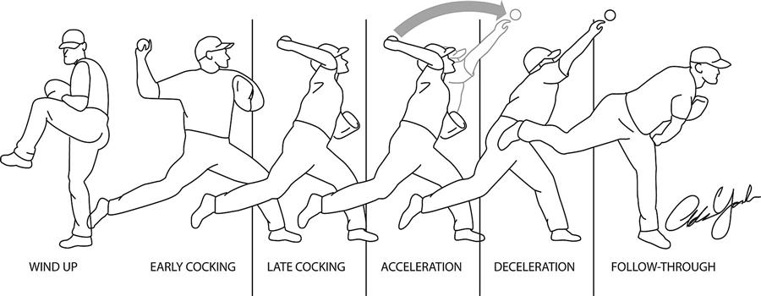
Throwing Athlete
Tremendous forces
140-160 km acceleration and then deceleration
Forces 5 times body weight – 7500 degrees/second
Fastest human motion in sports
Dynamic structures prevent injury to static restraints

Slide 6
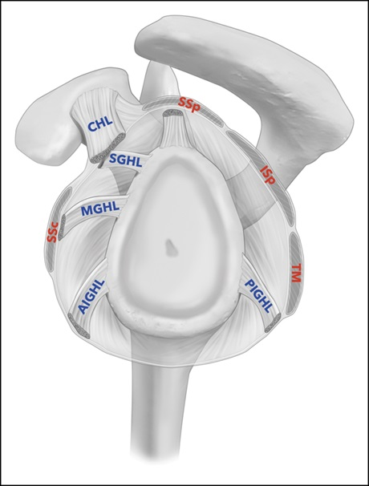
Introduction
Throwing
Acceleration
Slap
Internal impingement
RTC
Pasta
Deceleration
RTC eccentric
Latissimus and Teres Major
Slap tear

Slide 7
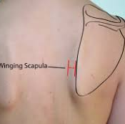
Examing throwing athlete
Kinetic Chain
Lower body
Torso
Evaluate mechanics
Throwing Shoulder
Stability
apprehension
Strength
Scapula - winging
Total Arc of Motion
180 degrees
IR symmetry

Slide 8
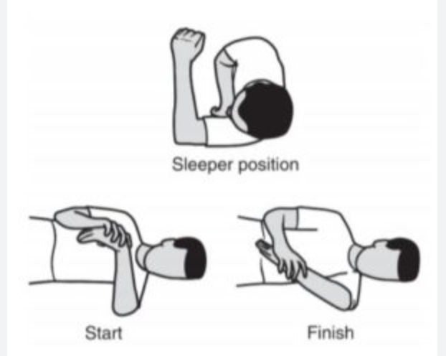
Examing throwing athlete
GIRD
Correlated with injury
Total arc – decrease
Internal impingement
Slap tests – obrien
Posterior capsular tightness
Scapula Dyskinesis
Scapula malposition
Inferior border
Scapula movement
Arm ER up and scapula pointed down

Slide 9
Rotator cuff - Throwing
Eccentric in deceleration
Acquired laxity of static stabilizers
Controls acquired instability
Rotator cuff
Non operative
Surgery - avoided
Internal impingement
Slap tears
Articular sided tears

Slide 10
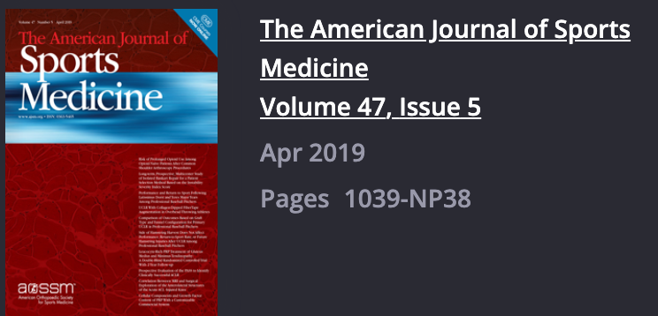
Shoulder Surgeries
Majority of surgery – Labral repair
RTC debridement second most
RTC internal impingement
63 percent return to play
86 percent same level
Epidemiology of Shoulder Surgery Among Professional Baseball Players
Peter N. Chalmers, MD*, Brandon J. Erickson, MD†,‡, John D’Angelo, BA§, Kevin Ma, BA§, and Anthony A. Romeo, MD†

Slide 11
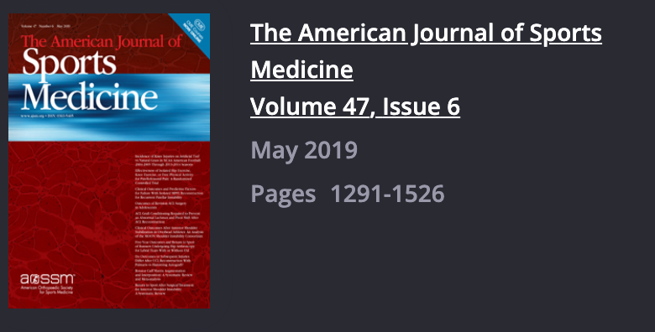
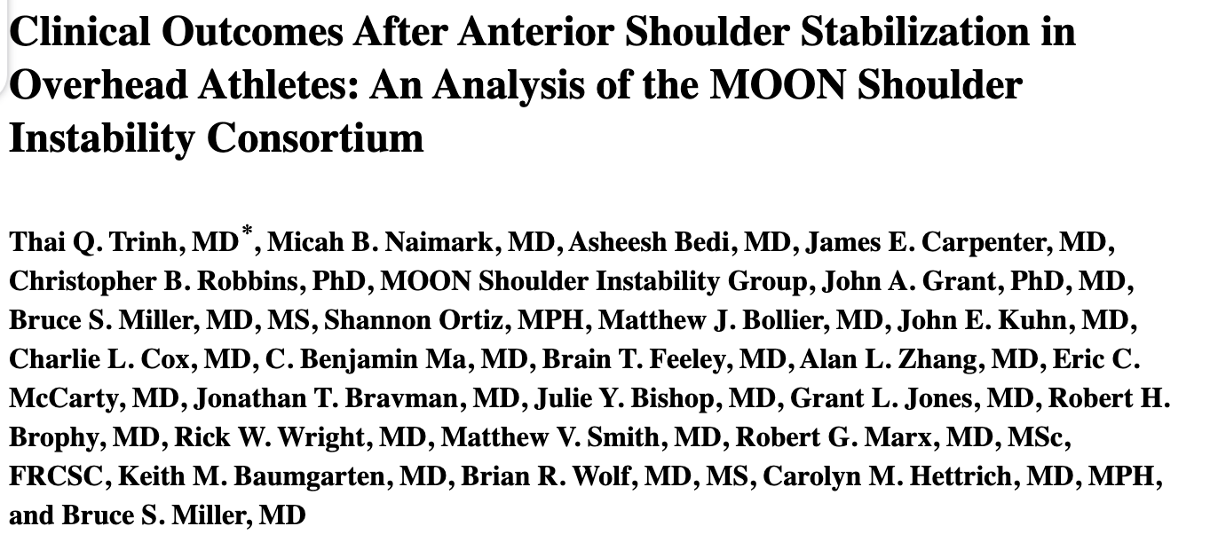
Shoulder Surgeries
63 percent return to play
45 percent return to previous level
Low-rate recurrence

Slide 12
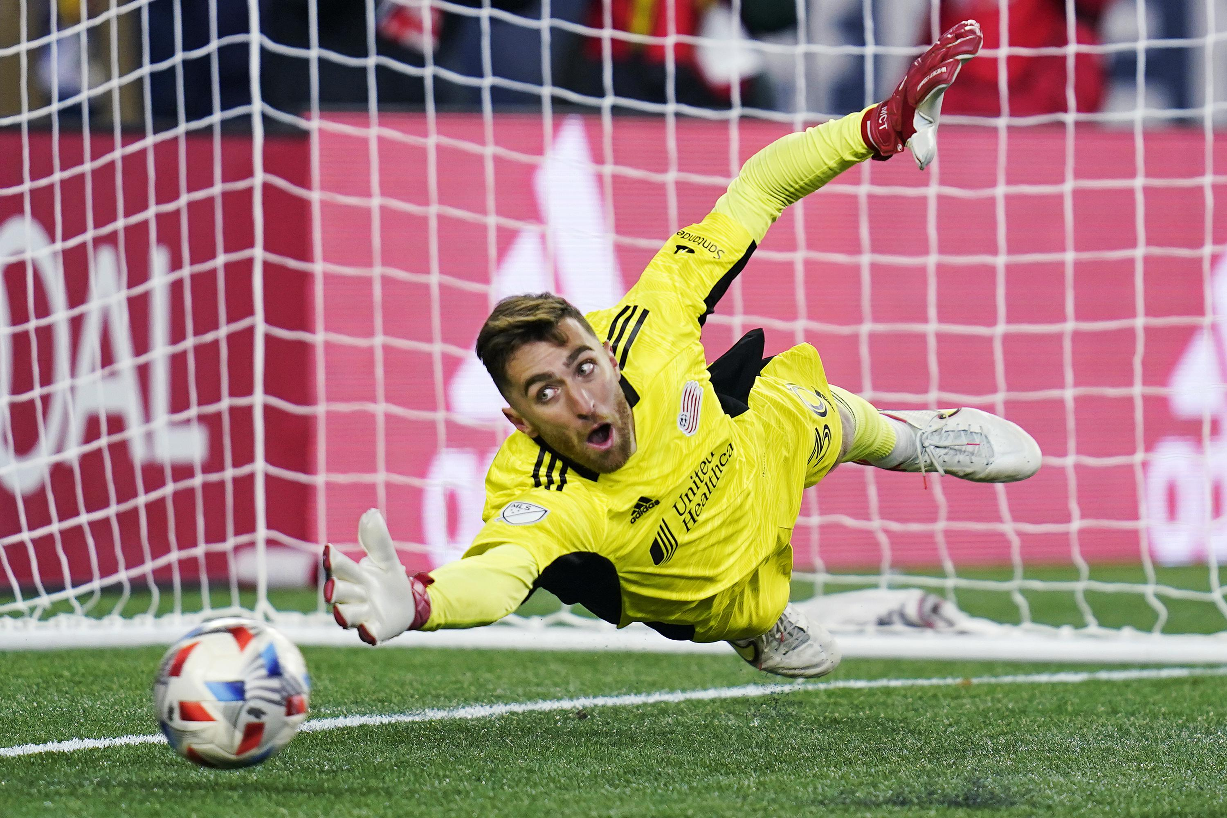
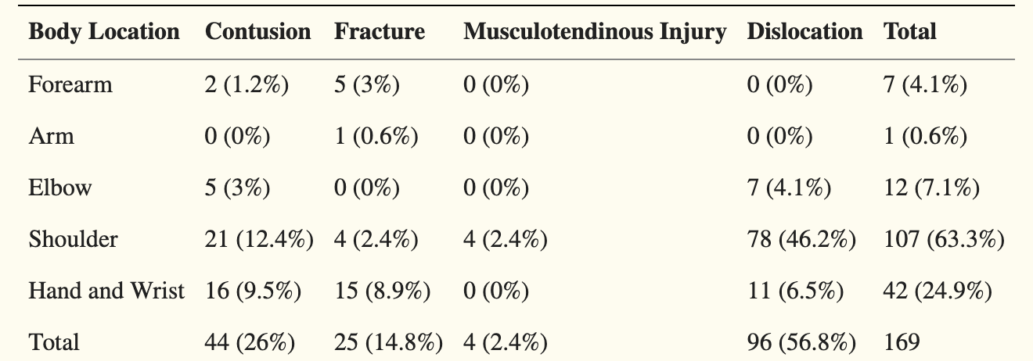
Upper extremity Injuries
Ekstrand et al. GK 5 times more likely to have upper extremity injury
Owens et al 4.6 times increase
High school similar results with most common in male(36%) and second most common in female(20.4%)
Brazilian soccer championships –Shoulder injuries in goalkeepers experienced the longest time to return to play

Slide 13
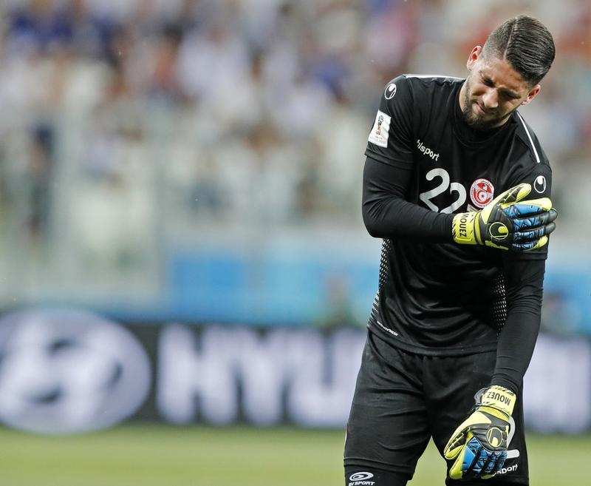
Incidence of Injuries

Slide 14
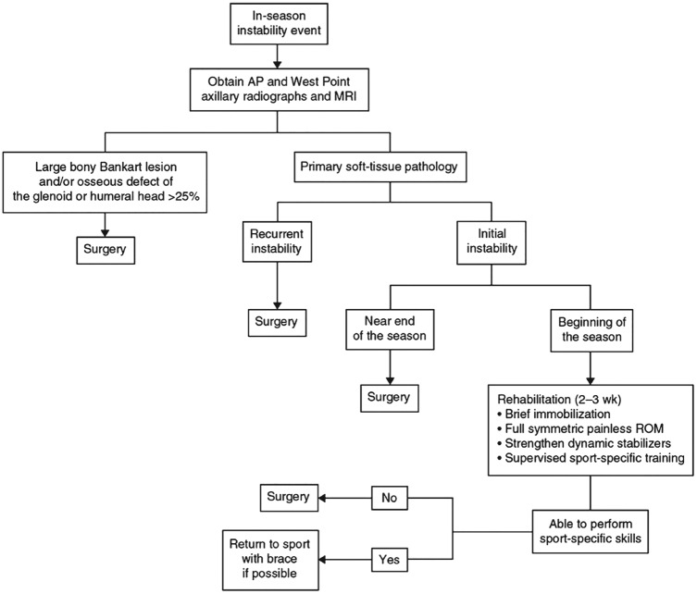
Shoulder Instability in the athlete In Season Dislocation
Sports Health. 2016 Jul; 8(4): 336–341
Non operative
Immobilization
Physical therapy
Rotator cuff strengthening
Scapular stabilizers
Return to sport
Pain free and demonstrate symmetric shoulder and bilateral scapular strength,
functional range of motion that allows sport-specific participation
14

Slide 15
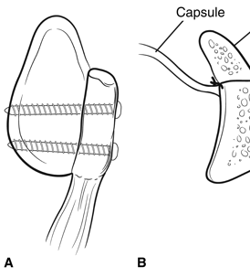
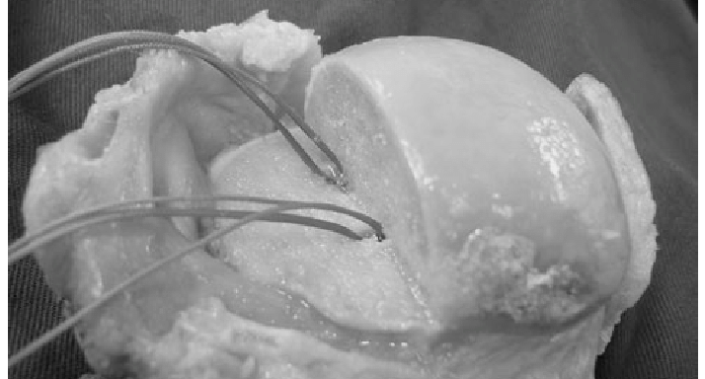
Shoulder Instability Athletes - Surgical Treatment Guide
Glenoid less than 25 percent on track
Bankart
Critical 13.5 percent – Latarjet in contact
Glenoid less than 25 percent off track
Bankart + remplissage
Contact athlete - Latarjet
Greater than 25 percent
Off track or on track
Latarjet
Boneblock

Slide 16
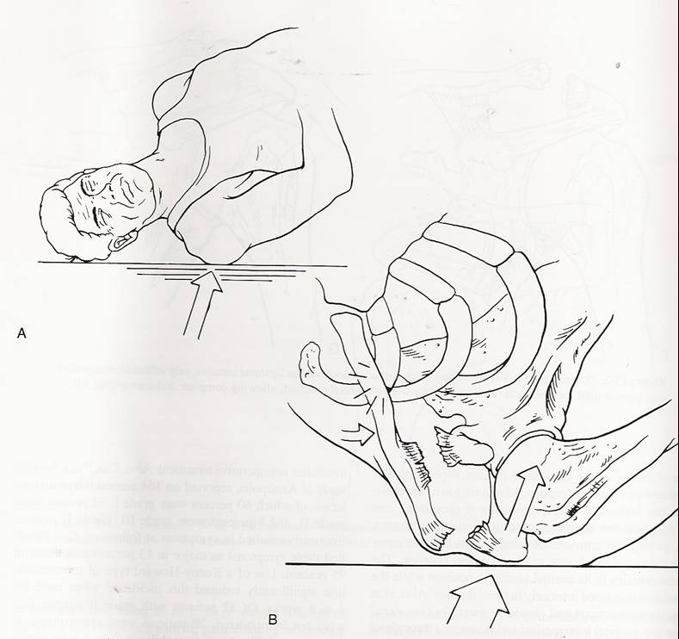
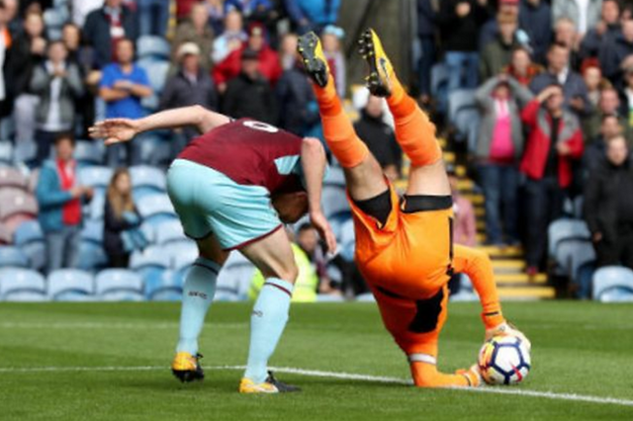
AC Joint
Common(Most common?) and significant for goalies
42 vs 18 days lost AC separation
24 vs 8 days for AC sprain
Nonsurgical management faster return
Surgery – controversial
Must understand anatomy and function
Most common cause of injury is direct force:
Falling onto the point of the shoulder with the arm adducted
Acromion is driven downward and medially

Slide 17
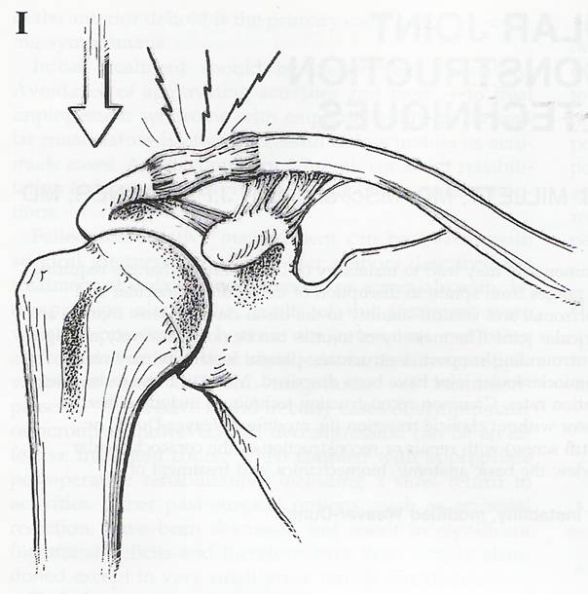
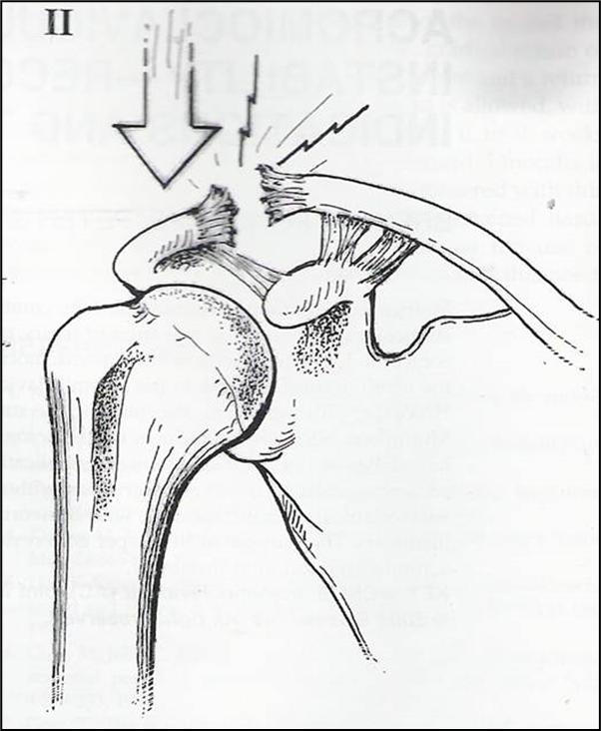
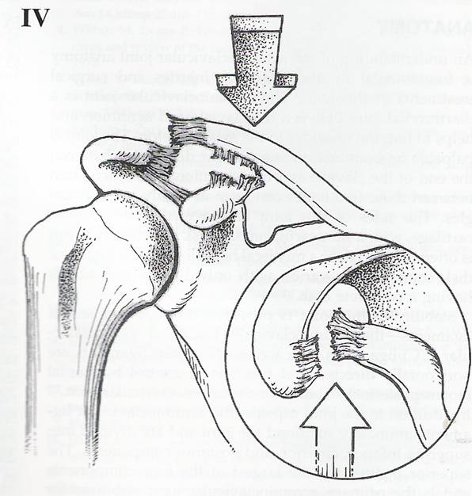
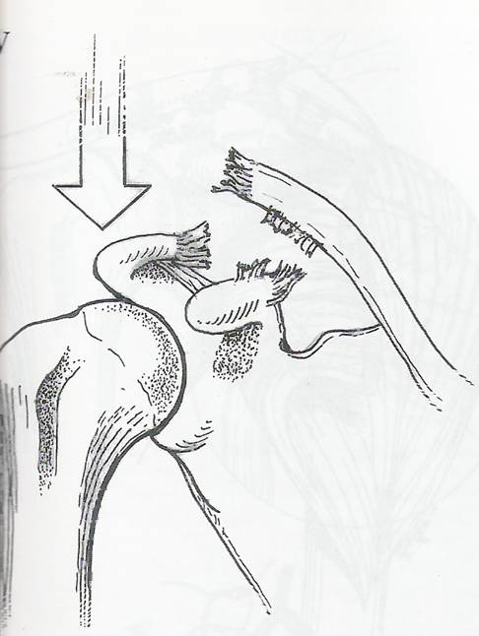
Classification Rockwood (6 types)
AC joint arthritis in the future
Ponce BA, et al. Op Tech Sports Med 2004;12:35-42.

Slide 18
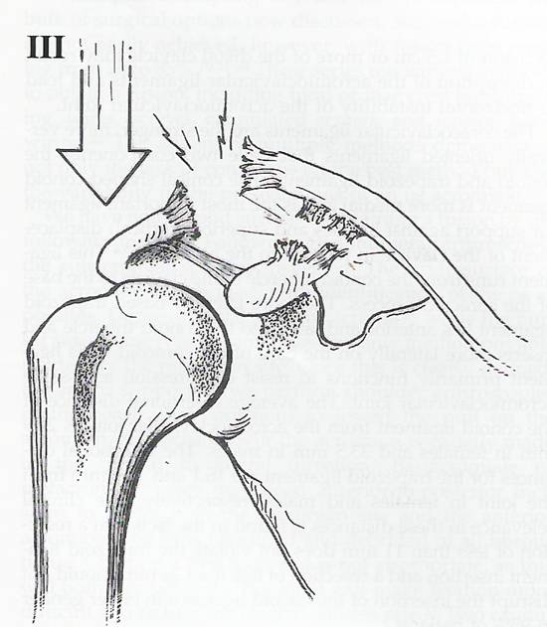
Type III
Complete AC dislocation
Complete disruption of AC and CC ligaments
25-100 percent displacement
3a – stable
3b – horizontal instability
Scapular dysfunction
Basmania/Alexander view
Overriding of the clavicle
Delto-trapezial fascia intact
Type 5 the fascia not intact
Ponce BA, et al. Op Tech Sports Med 2004;12:35-42.

Slide 19
Non-Operative Treatment
Non-operative modalities include:
Recommend a simple sling for short-term use followed by early motion when non-operative treatment is selected.
Rehab
Return to sport 4-6 weeks
Much faster than surgical
Throwers?
Cosmetic deformity

Slide 20
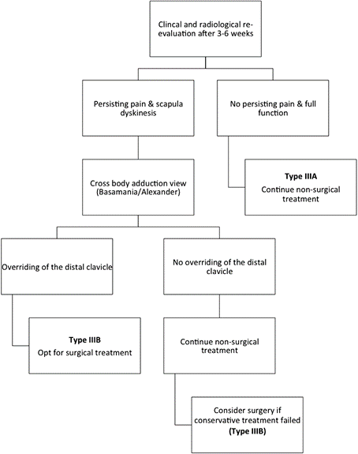
Algorithm for AC Separations
20

Slide 21
26 athletes – 25 85 percent or above
20 percent mild symptoms
Professional elite goalkeepers which required shoulder surgery for different causes demonstrated high-rate level of return to play despite the persistence of mild symptoms.

Slide 22
Injury Prevention Strategy
FIFA 11+ injury prevention program
Increase in GK injuries
Decrease injuries by improving strength, flexibility, Proprioception of the upper extremity, and core strengthening
3 stages
15 different warm-up exercises performed in the exact order and a specific number of repetitions performed at least twice per week

Slide 23
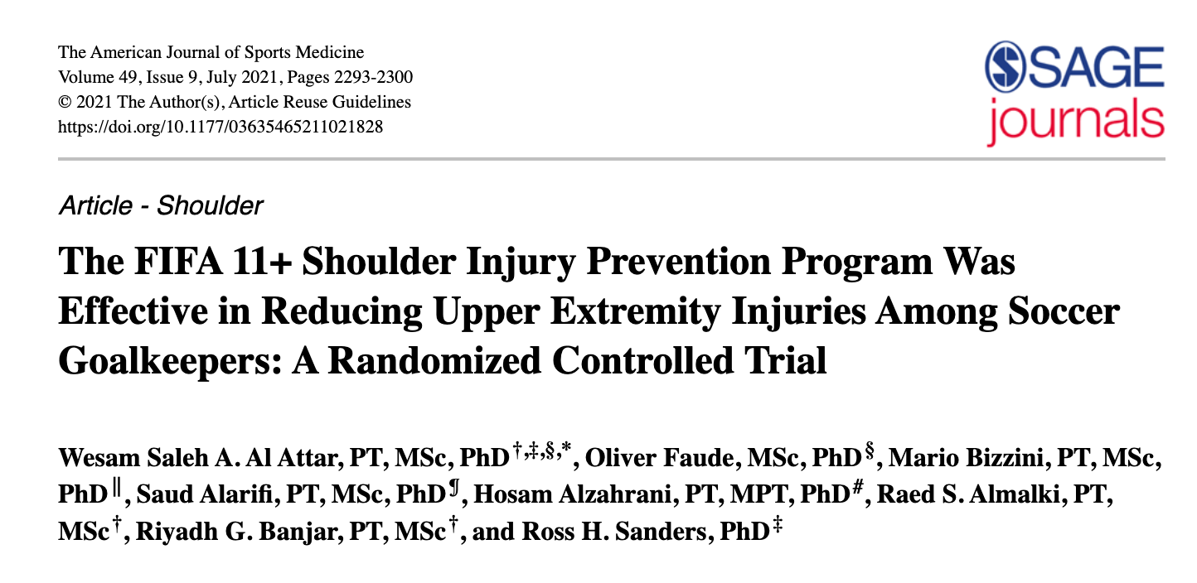
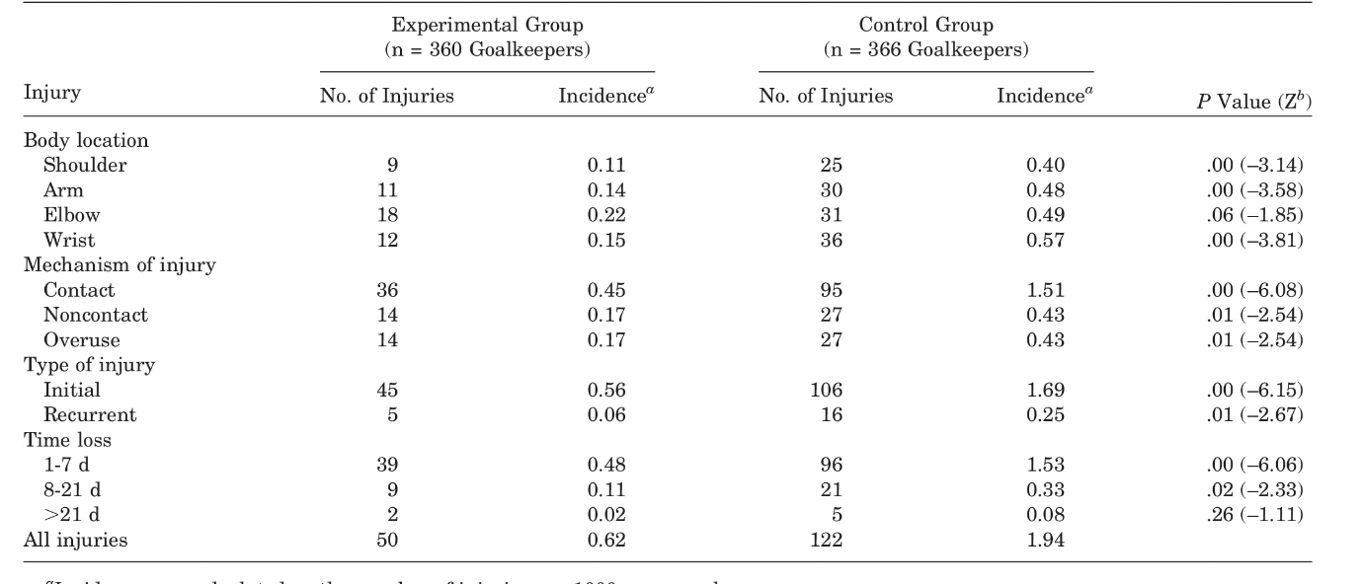
FIFA 11
RCT: FIFA 11+S program resulted in 50% fewer upper extremity injuries among soccer goalkeepers, compared with a regular warm-up.

Slide 24
Take Home Message
The athletes shoulder complex
Understand throwing vs. non throwing athletes
Contact vs. non contact
Throwing shoulder mechanics
Forces dynamic and static
Understand when surgery is needed
RTP low with surgery and longer time frame
Football – Goalkeeper injuries
In season vs off season treatment
RTP is high after surgery
THANK YOU

Slide 25
THANK YOU

